Slide 1
STA Interview
崔驰坤
崔驰坤
Cui, Richard Chikun
微信15640888106
06/01/2020 | CIO China Rapid
微信15640888106

Slide 2
Agenda
崔驰坤
崔驰坤
01.
04.
Self-introduction (5’)
Showcase #2: Cloudification for Roche (10’)
Client: Roche
Category: Client Facing
微信15640888106
02.
05.
As CIO Rapid Tech Lead (5’)
Showcase #3: Contract Insights Platform (CIP) (10’)
Client: Accenture Legal
Category: Architecture Review & New Opportunity
微信15640888106
03.
Showcase #1: BizTech Navigator Platform (10’)
Client: Accenture Strategy
Category: In Production

Slide 3
01
崔驰坤
Self-introduction
崔驰坤
微信15640888106
微信15640888106
Cui, Richard Chikun

Slide 4
Self-introduction
崔驰坤
Cui, Richard Chikun
  CIO China Rapid Tech Arch Lead, we have 65 members cross 2 locations (Shanghai – retro city, Dalian – 3rd line city) and 5 certified Accenture Tech Arch and 3 certified Tech Arch Associate.
  Joined Accenture from 2015, Before Accenture I have 9 years .NET enterprise web application development, architecture and IT management experiences (Architect and IT Technical Director in 2015, former company which have 6000 stuff in China and 200 stuff in Japan).
  Now normally working on 2-3 projects as Tech Arch, support Tech Arch group and community activities in CIO, push learning sessions in Rapid with latest Tech Trends, help internal and client facing proposals.
崔驰坤
微信15640888106
微信15640888106

Slide 5
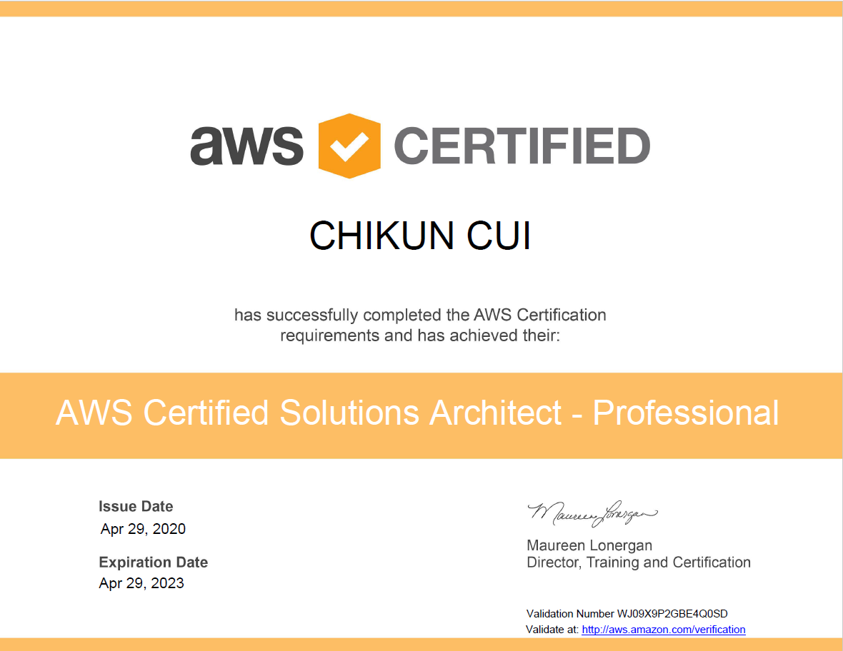
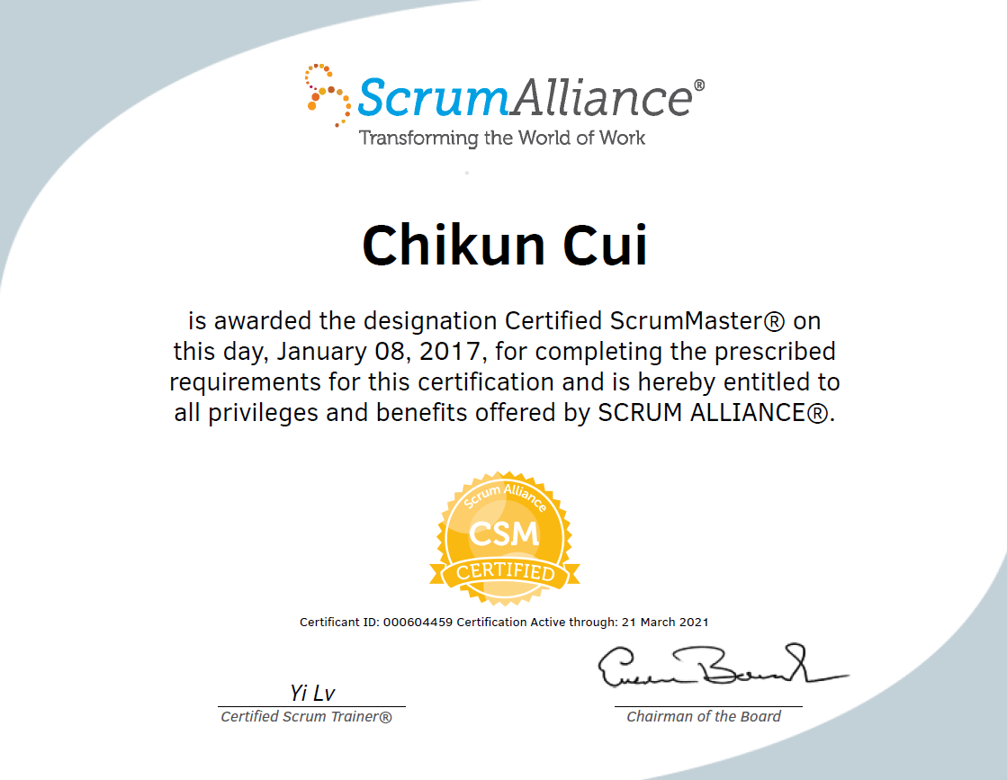
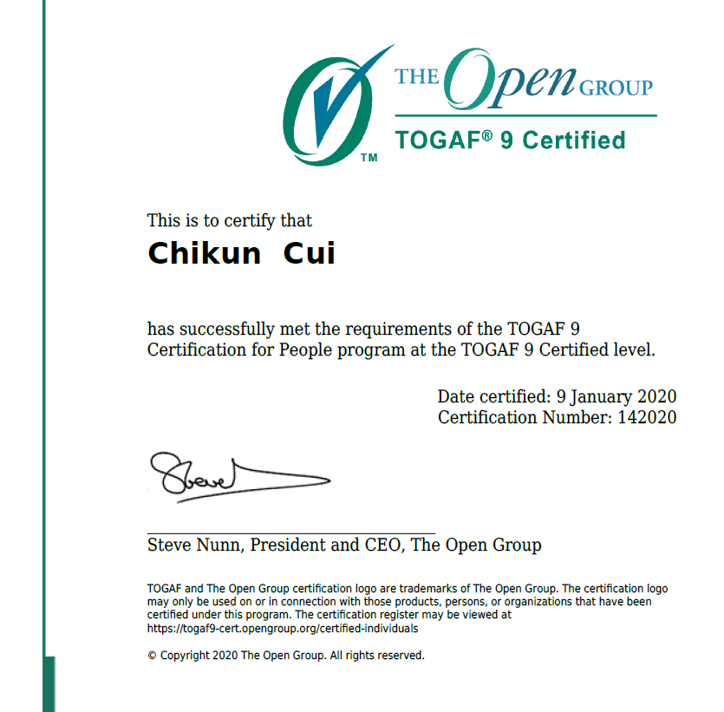

Certifications
崔驰坤
Certified as:
    Certified IBM DB2 professional/administrator/developer in 2005 (University)
    Microsoft Certified Database Administrator (MCDBA) in 2007
    Project Management Professional (PMP) in 2012
    Accenture Agile Professional in 2016
    Accenture Technology Architect in 2017
    Certified SCRUM Master (CSM) in 2017
    TOGAF 9 Certified in 2019
    AWS Solution Architect – Professional in 2020
In Progress & Planning
      Microsoft Azure Solution Architect – Professional
        AZ-301 passed
        AZ-300 is on the way
      Google Cloud Platform Solution Architect
      AliCloud Solution Architect
      Cloud Security Certification
崔驰坤
微信15640888106
微信15640888106
https://www.linkedin.com/in/richardcuick/

Slide 6
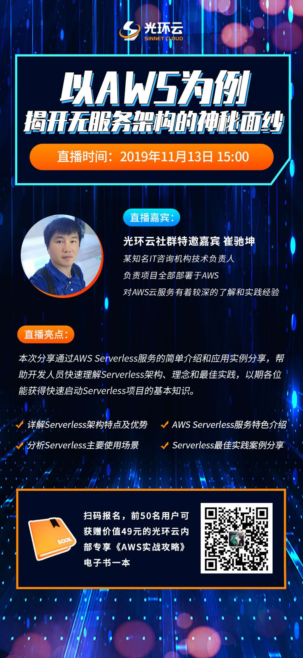
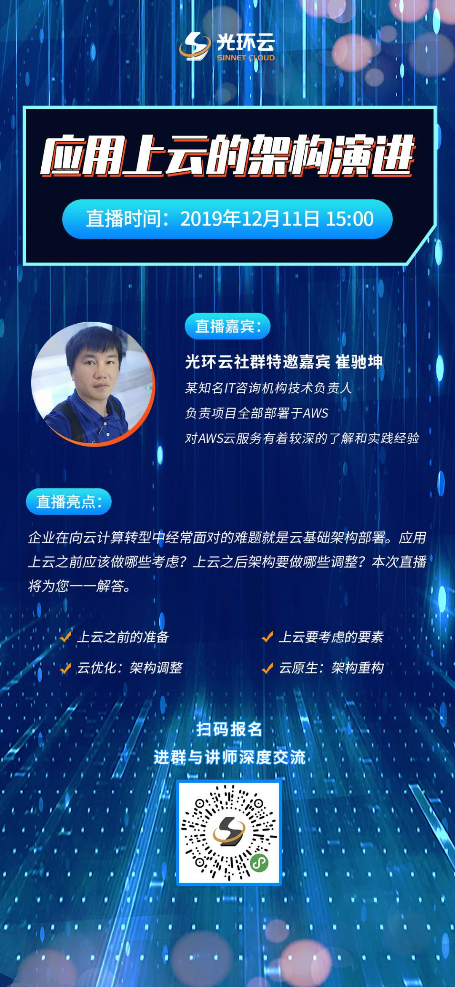
Contributions
崔驰坤
Shin-net Cloud AWS Lecturer
(External)
    Sinnet Technology Co., Ltd. (Sinnet) is service operator and provider for AWS China (Beijing) Region.
    2 online sessions with 660+ and 2200+ online audiences.
        AWS Serverless Architecture 13th Nov, 2019
        Cloudification and Architecture Evolution 11th Dec, 2019
崔驰坤
微信15640888106
微信15640888106

Slide 7
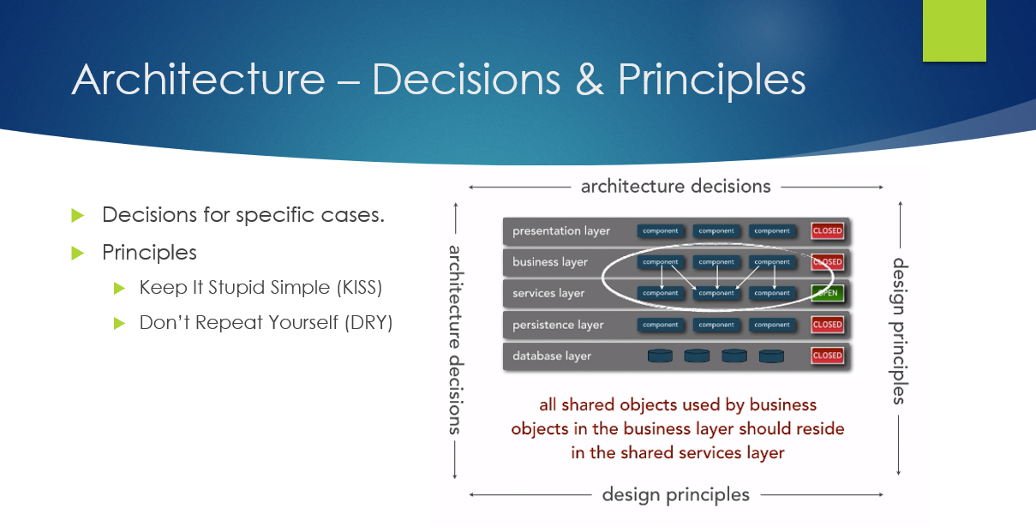
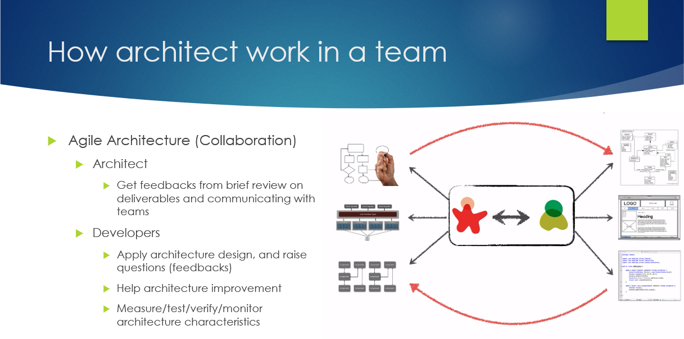
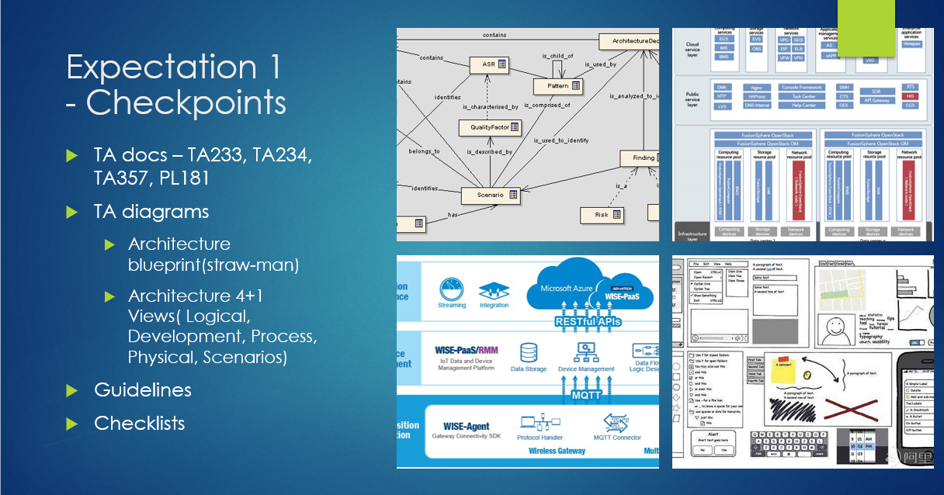
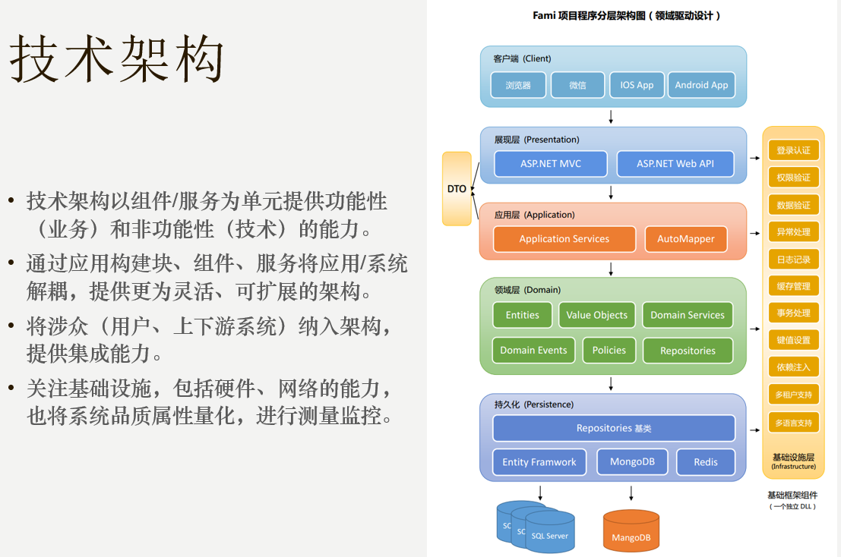
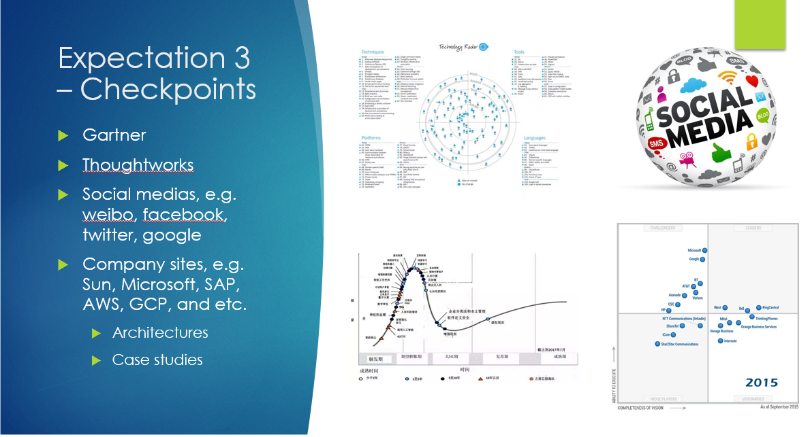
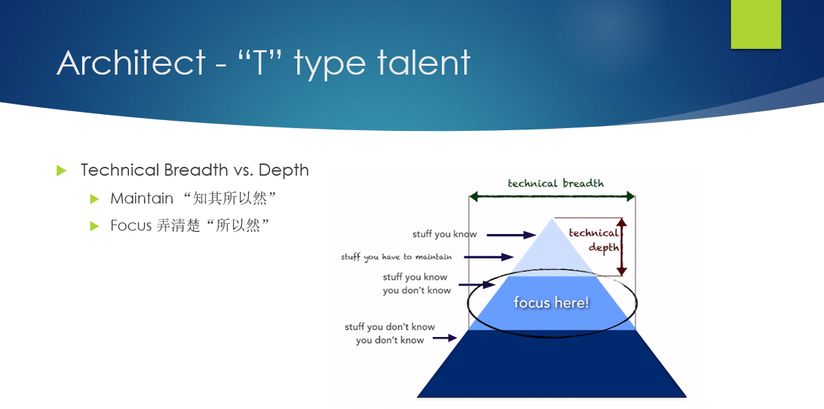
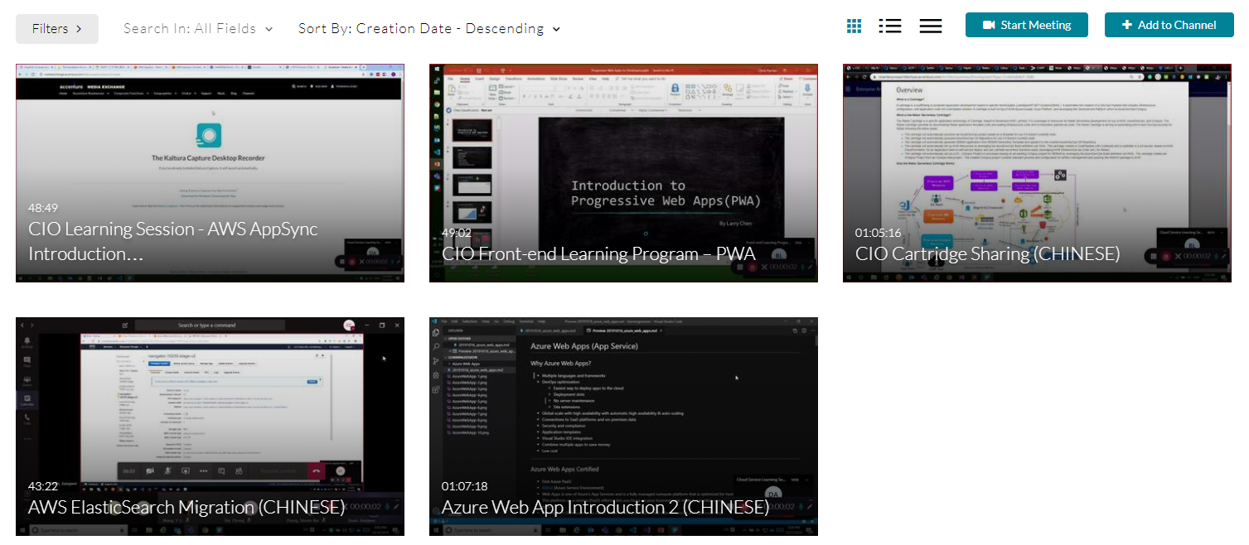
Contributions
崔驰坤
Tech Arch Group Executive
(CIO China)
    Learning Sessions (10+) on:
        Technology Architecture
        AWS
        Azure
        GCP
        Full Stack
      MTA Promotion Program
        FY19 Certified: 1 TAs, 2 TAAs
        FY20 Certified: 2 TAs, 2 TAAs
        FY20/21 Goal: 2 STA, 20 TA, 40 TAAs
崔驰坤
微信15640888106
微信15640888106

Slide 8
02
崔驰坤
CIO Rapid
Tech Lead
崔驰坤
微信15640888106
微信15640888106
Cui, Richard Chikun

Slide 9
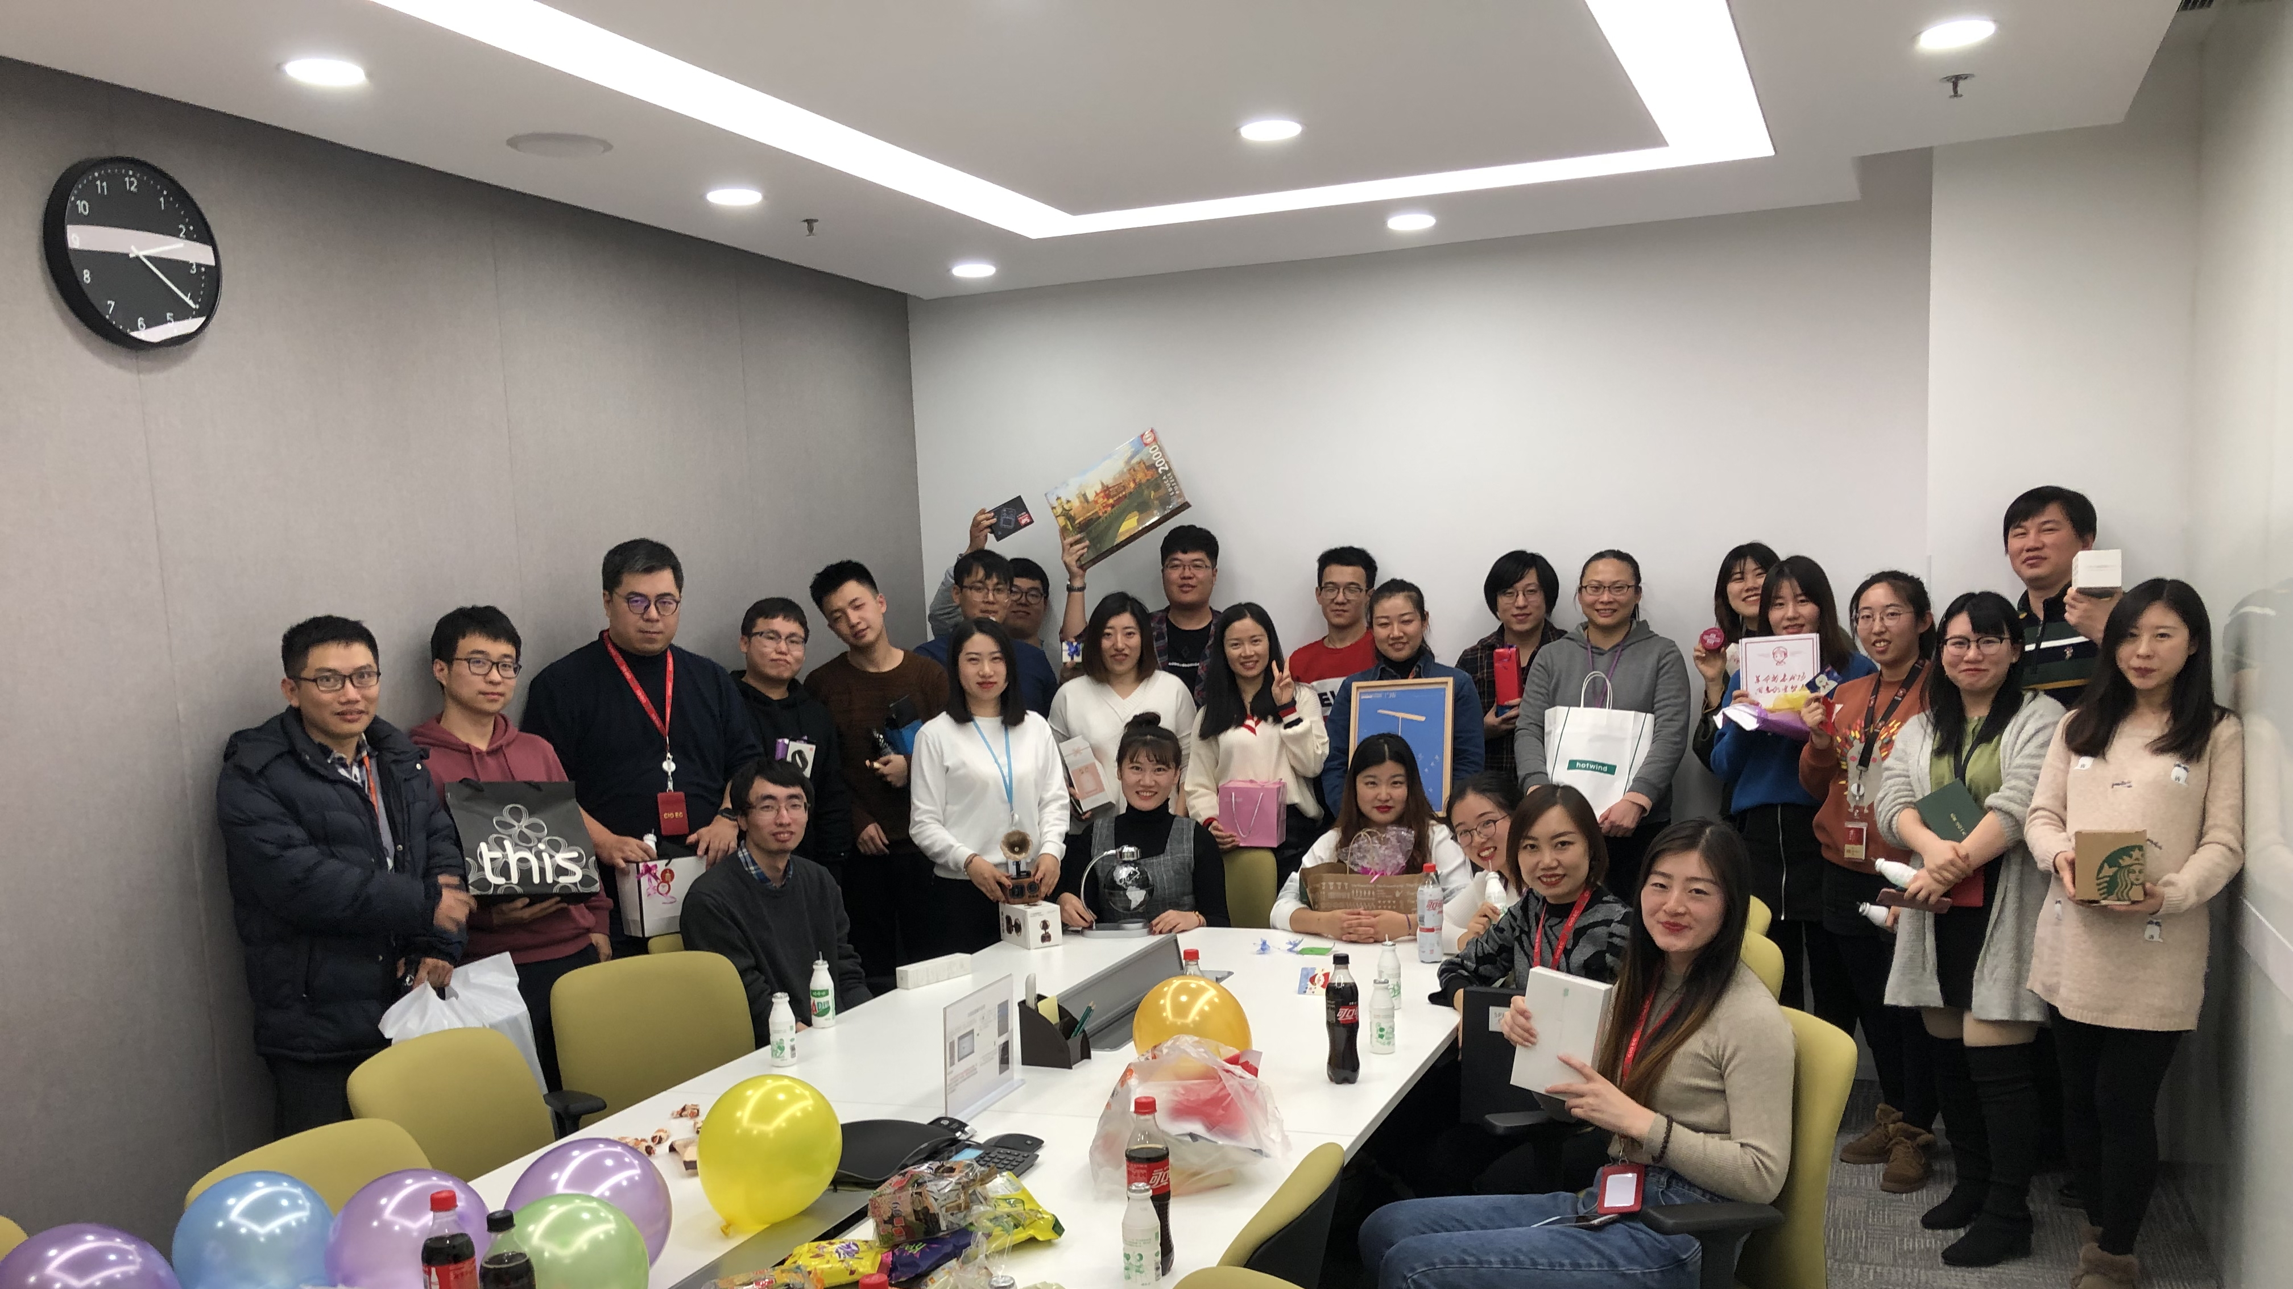
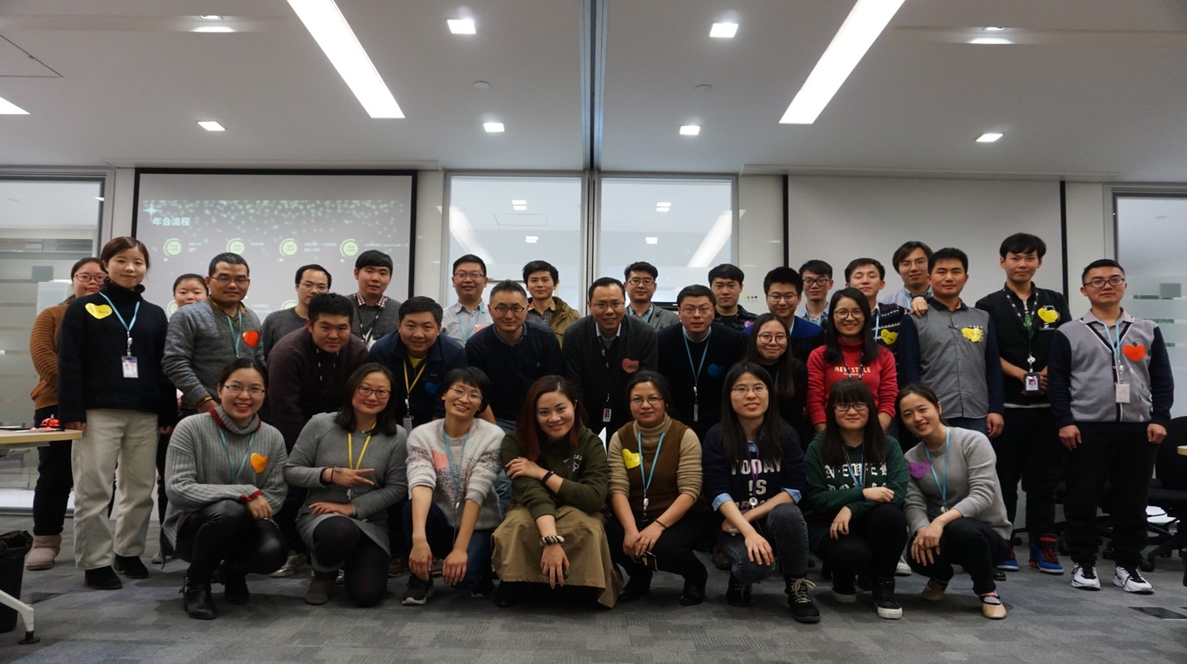
Background
崔驰坤
Scale Agile and DevOps capabilities through Enterprise Transformation.
Building up Cloud Platform capabilities through partnerships with Amazon (FY15), Azure (FY17), Google (FY19), AliCloud (FY21).
Provides New IT capabilities to CIO global locations
崔驰坤
微信15640888106
微信15640888106

Slide 10
Tech Trends
崔驰坤
History
Future
崔驰坤
2015-2016 Mobility, API management
  Hybrid Mobile App
  Responsive Layout for both Mobile and Web app
2017-2018 Cloudification, PaaS
  IaaS, Auto Scaling, High Availability
  PaaS, Serverless for cost-efficient
2019-2020 Data-centric, Microservices
  Data Ingestion, Data Insights, Data Visualization
  Data Governance
2021-2025
  Kubernetes/Container Services
    Infrastructure as Code
    Intelligent Operations
  Application Lifecycle
    Chaos Engineering
    Automatic DevSecOps Pipeline
  Intelligent Data Insights
  Lower Development Platform
微信15640888106
微信15640888106

Slide 11

How we help our clients
Cost
Cost Efficient
Pay As You Use
崔驰坤
Experience Modern UI
NEW IT
Security
Quality
Availability
崔驰坤
微信15640888106
微信15640888106
Value
Fast to Market
Flexibility
Opportunity
Collaboration
Industry Lead

Slide 12
Experience Modern UI
NEW IT
Experience Modern UI
NEW IT
We drive in CIO china
崔驰坤
NEW IT STRATEGY
崔驰坤
Cloud
  Move legacy system to next generation PaaS (Platform as a Service)
Microservice
  Adopt Microservices architecture to enable agile and efficient software delivery
Serverless
  Pay as you use services enable fast prototype, high availability and scalability with cost reduction
CDS – UI Designer
  Fast prototyping, reusable UI components
微信15640888106
微信15640888106
Cost
Cost Efficient
Pay As You Use
Cost
Cost Efficient
Pay As You Use
Value
Fast to Market
Flexibility
Value
Fast to Market
Flexibility

Slide 13


NEW TECH, NEW CLOUD (FY19)
 | 2013 | 2014 | 2015 | 2016 | 2017 | 2018 | 2019
 | ASP.NET MVC Batch Job (.NET) | Tableau QlikView AngularJS Ionic BDD (Cucumber) BDD (SpecFlow) | NodeJS ASP.NET Web API Swagger (Open API) Selenium Angular 2 Docker | WordPress (PHP) Angular 4 Scala (Java) Orchestrator (PowerShell) .NET Core Python | Drupal (PHP) ElasticSearch R Angular 6 TypeScript | Serverless Framework Angular 7 Kubernetes Hadoop | Plan: Big Data AI IoT
崔驰坤
崔驰坤
微信15640888106
 | 2013 | 2014 | 2015 | 2016 | 2017 | 2018 | 2019
 | AWS EC2 AWS ELB Auto Scaling Group | AWS RDS SQL Server Azure VM Azure Storage Account | Azure Web Apps AWS S3 AWS CloudFront AWS Route53 AWS SNS | AWS Lambda (.NET Core) AWS Lambda (Python) AWS API Gateway AWS DynamoDB Azure SQL | AWS Aurora AWS ElasticSearch | AWS CodePipeline AWS CloudFormation Azure Service Fabric | Plan: Microservice Serverless And new cloud services support NEW IT technologies
微信15640888106

Slide 14
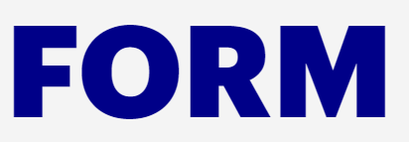
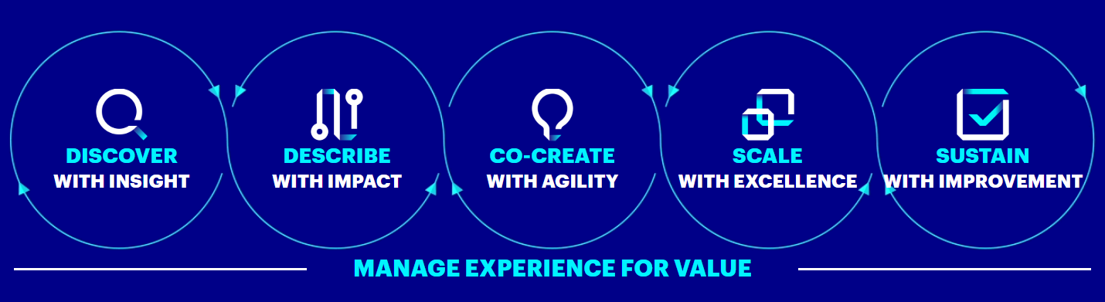
Opportunity
Collaboration
Industry Lead
Opportunity
Collaboration
Industry Lead
We drive in RAPID CHINA ORG
崔驰坤
NEW IT DRIVEN
崔驰坤
Core Delivery
  Client oriented delivery toward global markets
Innovation Lab
  New IT Practice and Assets
Liquid Studio
  Reusable MVP assets for domestic markets
Design Thinking
  Idea generation on existing and potential business opportunities
微信15640888106
微信15640888106
Security
Quality
Availability
Security
Quality
Availability

Slide 15



We explore: what does customer exactly ask for?
崔驰坤
With RAPID Methodology and Tools:
  Explore functional requirements and look forward to expectations and visions from customer.
  Clarify functional and non-functional requirements based on assumptions and work with feedback.
  Create MVP(Minimum Valuable Product), reuse existing components, refer business process or logic with records or from role models then iterate with Scrum sprints.
  Engage with functional verification, empathize and thinking in. Innovate how to enhance or optimize.
  Organize NEW IT practices and assets for upcoming requirements.
崔驰坤
微信15640888106
微信15640888106

Slide 16








Drive GROWTH WITH NEW IT TECHs
Cloud Computing
Move legacy system to next generation PaaS (Platform as a Service)
Serverless
Pay as you use serverless services enable fast prototype, high availability and scaling with cost reduction.
Microservices
Adopt Microservices architecture to enable agile and efficient software delivery
崔驰坤
崔驰坤
UI Design Studio
Fast prototyping, reusable UI components.
Mobility
Grow business with mobile users and enable rich and accessible experiences.
NEW IT
微信15640888106
微信15640888106
Innovation
Apply design thinking and FORM during analytics and designs.
Security
From data store to application, secure sensitive data with security specifications.
Agile
Fast act with short sprint than traditional project

Slide 17
OBERSAVE and act with “-FIRST” WAVES
WEB-FIRST
Every day to innovate and to improve value for our clients. From robust Content Management Systems to data visualization.
MOBILE-FIRST
With product design principles to improve designers’ productivity, pay more attention to the contents and create neat and practical designs.
03
崔驰坤
Options
崔驰坤
01
Options
微信15640888106
CLOUD-FIRST
Cloud migration delivered impressive cost reduction. And customers are able to streamline and coordinate global operations and improve overall productivity and collaboration.
DIGITAL INTELLIGENCE
Take advantage of new digital technology to acquire and apply new knowledge and skills, improve effectiveness and outcomes.
微信15640888106
02
Options
04
Options

Slide 18
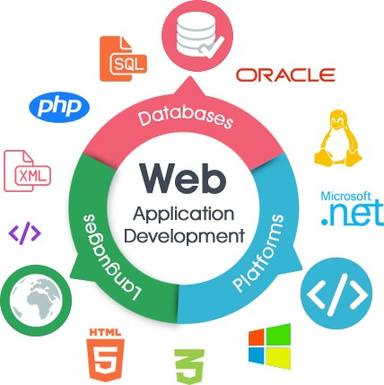
We build Web with brand new experiences
崔驰坤
Engaging User Experiences with Modern Web Apps
  Interactive and rich frontend with market leader framework.
  Standardize design with unified web assets.
  Fast prototype with reusable UI components.
  Code, Test, Deploy with modern web CI/CD process
Use Cases
  Packaged and custom web apps based on ASP.NET, NodeJS, PHP, etc.
  Web CMS e.g. Orchard(.NET), WordPress(PHP), Drupal(PHP), SharePoint, etc.
  SPA with RESTful API in .NET, PHP, Node.js and etc.
崔驰坤
微信15640888106
微信15640888106

Slide 19

We build Mobile-first and hybrid app
崔驰坤
Anytime, Anywhere and even faster than web app
  Design and implement mobile app with responsive layout.
  Cost efficient for a hybrid app with both web and mobile.
  Fast prototype with CDS (UI designer)
  Consume data via secured RESTful APIs
Use Cases
  Learning app: Course attendees can request course news, schedule, materials and feedback.
  Control app: Monitor with sensors and control IoT devices remotely.
  Admin app: Approve in workflow or accept/reject an event remotely.
崔驰坤
微信15640888106
微信15640888106

Slide 20
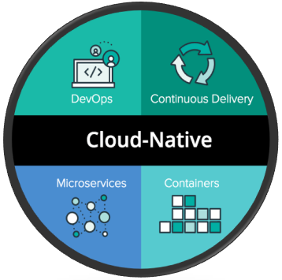
We build cloud native app
崔驰坤
Fast To Market, Cost Efficient
  Migrate legacy app to Microservice or Serverless.
  Create/deploy with cloud services in seconds.
  Reduce cost and effort without paying for idle server management effort.
Use Cases
  Migrate legacy web apps to microservice platform without any code changing.
  Reflect on-premise web app to serverless web app only pay for usage (requests) with high availability and scalability.
  Apply Cloud Service without managing servers e.g. patch, upgrade, virus detect and kill.
  Secure your services and data with latest world-class security methods.
崔驰坤
微信15640888106
微信15640888106

Slide 21

We Build Intelligence
崔驰坤
Help Customer Win In Future
  Automate to decrease computing resource waste,
  reduce management cost and effort, save time for end users.
  Build flexible workflow to simply process.
  Extend with intelligent and digital solution, e.g. search, recommend, bot and etc.
Use Cases
  Chat bot: Identify end user purpose and give quick response with KB, learn from experiences.
  Recommend: Rank contents with views, likes, comments and keywords. Recommend with relative and hot ones.
  Search: Search with keywords, filters, scope, permissions etc.
  Digital analytic: Look for features and patterns in data and learn how to use them.
崔驰坤
微信15640888106
微信15640888106

Slide 22
Cloud: Serverless & Microservices
  For new created small web app/portal, use AWS Serverless (FY19-FY20)
          Cloud Access Provision Portal
          CCS Office Portal
      Migrate legacy or create new medium/large with container services (with Microservices architecture)
          Google Kubernetes Engine (GKE) is your option for greenfield apps in Linux containers
          Azure Service Fabric is your option for legacy apps in Azure
          Google Cloud Run will be an option for new apps on Linux
          AWS’s Elastic Container Service (ECS) and Fargate will be an option for legacy apps in AWS
          (FY21-)
崔驰坤
崔驰坤
微信15640888106
微信15640888106

Slide 23
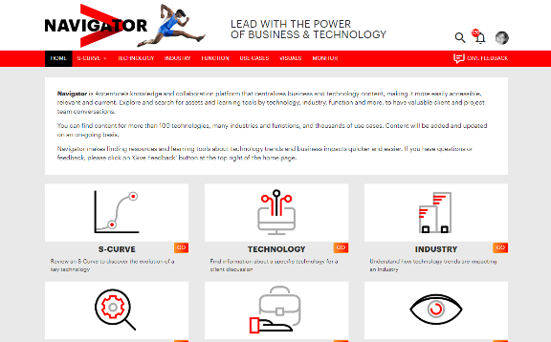
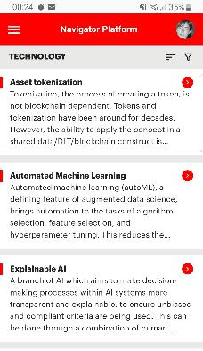
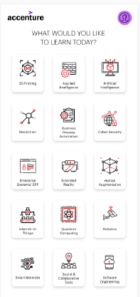
Frontend & Mobility
  Angular
  Decoupled Frontend Architecture
  PWA (Progressive Web Apps) for web browser app
  Ionic for mobile native app
  Angular 9 (with ‘Ivy Engine’ and 40% package)
  Micro-frontends
崔驰坤
崔驰坤
微信15640888106
微信15640888106

Slide 24

Frontend: Angular
Angular
  Angular 8 is recommended by CIO EA.
  approximately of 500 KB size (the biggest in three), but work well with enterprise-level web app and able to speed up with decoupled frontend architecture and cloud CDN. And easy to work with Ionic for hybrid mobile native development.
React
  Widely used for social web app. approximately 100 KB size.
Vue
  Widely used for hybrid mobile app or lightweight web app named “mini program” works along with mobile native app, e.g. wechat.
崔驰坤
崔驰坤
微信15640888106
微信15640888106

Slide 25
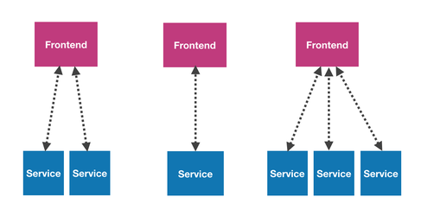
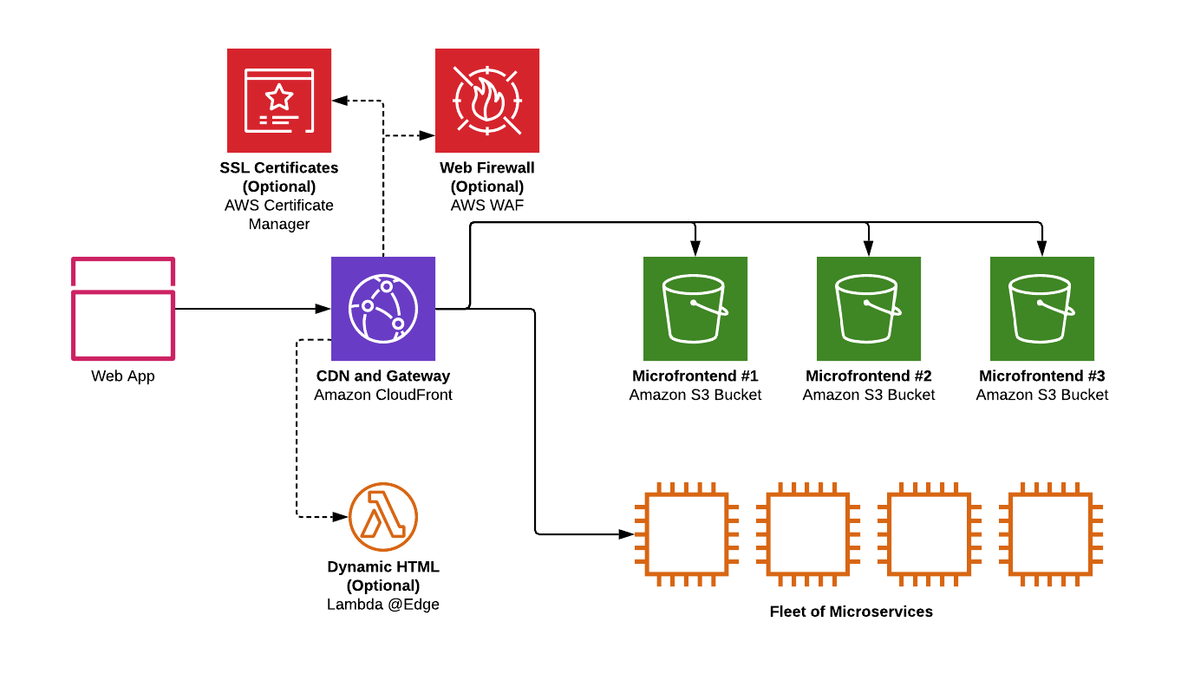
Frontend: Decoupled Frontend Architecture
Decoupled Frontend Architecture
Application frontends and backends live in separate repositories and are deployed independently. Frontends retrieve data from services via well-defined, versioned APIs. Separate frontends map to different domains – each frontend is focused on one specific use case. A single frontend can call into multiple services if necessary.
Cloud Decoupled Frontend
    Store static files on S3 bucket
    Caching with CloudFront
    Do dynamic process with Lambda@Edge, e.g. SSO integration
崔驰坤
崔驰坤
微信15640888106
微信15640888106

Slide 26

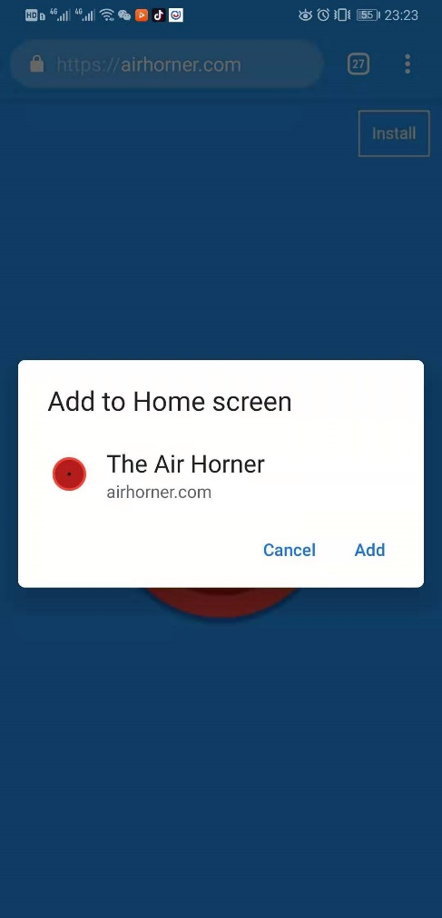

Mobility: Progressive Web App
A new mobile app standard
Offline caching
Better use experiences
No need for marketing approval, installation of app or version update
Login website via PWA first time will get an icon on mobile desktop, click this icon to visit for future
崔驰坤
崔驰坤
微信15640888106
微信15640888106

Slide 27
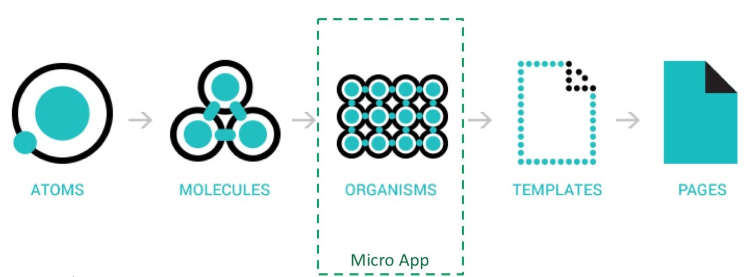
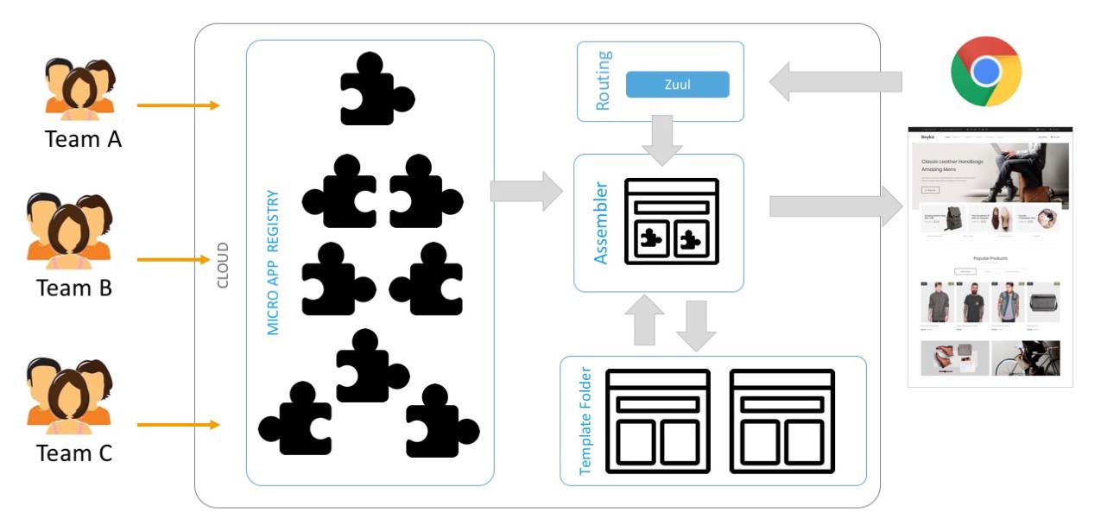
Mobility: Micro-frontends
The app is broken down into smaller micro apps bound by visual context.
Each app is independent, it can fetch its own data and has its own encapsulated styling.
These Micro App don’t share a global state.
Each team can work on their micro app independently and deploy them independently.
崔驰坤
崔驰坤
微信15640888106
微信15640888106

Slide 28
03
崔驰坤
BizTech Navigator
Platform
崔驰坤
微信15640888106
微信15640888106
Showcase #1

Slide 29
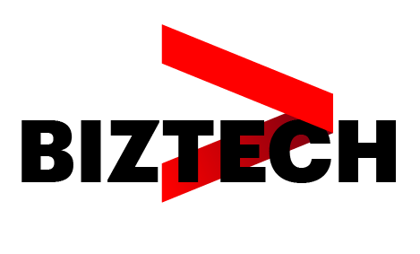
Background
崔驰坤
Accenture Strategy leadership want a CMS for content assets collaboration and management.
We have negotiations and interviews with strategy team members in different roles of content collaboration process. Try to figure out all challenges, opportunities, expectations.
We use methodologies to dig deep with Accenture FORM and design thinking tools e.g. Prototype, etc.
崔驰坤
微信15640888106
微信15640888106

Slide 30

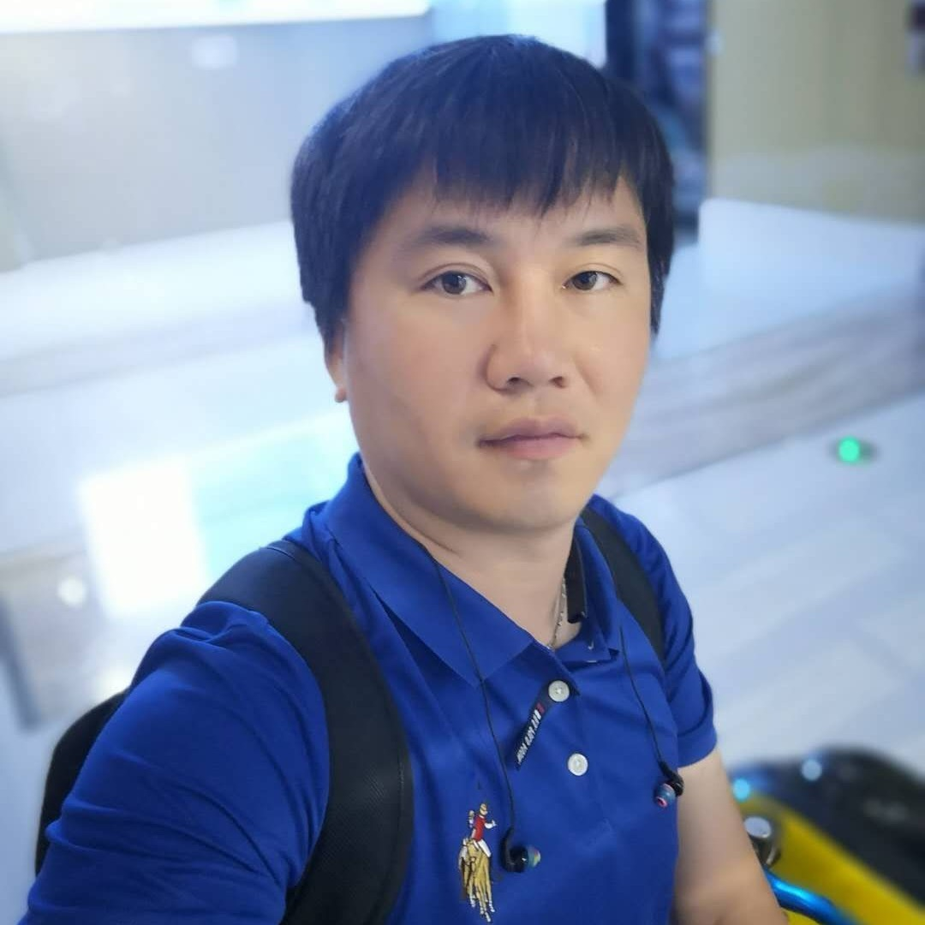


TEAM
Biz Tech Navigator Platform
崔驰坤
崔驰坤
微信15640888106
微信15640888106
Troy M. Quick
  Managing Director
    Troy Quick is a Managing Director in Accenture Strategy's Integrated Operating Model practice.
Cui, Richard Chikun
  Technology Architect Lead
  Delivery Manager
    Richard works as TA lead in Accenture CIO China Rapid Delivery Offering. CIO China Rapid develops the NEW IT capabilities for digital transformation.
Paola Tomasoni
  Product Owner
Jane Cowling
  Offering Development Lead
    Global Offering Lead for Competitiveness, BizTech, and CI&GS Find Growth in Accenture Strategy practice, after recently serving as Global Offering Lead for the Digital Strategy COE.
30

Slide 31
WHAT WE HAVE DONE
崔驰坤
RESEARCH
User Interviews
Product Research
崔驰坤
Stakeholder Requirements
Cost of Locked Potential
Ecosystem Research
Author Interviews
Persona Creation
PRODUCT
CONTENT
Data Models
微信15640888106
Content Audit
Architecture Blueprint
Website Analysis
微信15640888106
Delivery Centre Identification
Content Strategy
Security Integration
Site Map
CMS Platform comparisons
Content for Prototype
Product Selection
Content Mapping
Analytics assessment
Taxonomy

Slide 32
ECOSYSTEM, USERS AND USAGE RESEARCH
崔驰坤
RESEARCH
User Interviews
Product Research
崔驰坤
Stakeholder Requirements
Cost of locked potential
Ecosystem research
Author Interviews
Persona Creation
Interviews with 12 TEAMS
IN existing Projects
Interviews with
16 people from
3 geographies
7 countries
3 functions
5 industries
Discovered
3 Personas
and journeys for Consumers
And 5 Author mindsets
微信15640888106
微信15640888106

Slide 33

KEY FINDINGS FROM AUTHOR INTERVIEWS
崔驰坤
崔驰坤
TEAM STRUCTURE
& INCENTIVES
governance
CONTENT lifecycle
“We don’t have dedicated teams…the same people who are being pushed to sell and deliver our revenue"
“I don’t know of much stuff that is updated, usually a new version comes out”
"It's a lot to ask of people who are fully billable”
微信15640888106
微信15640888106
PROCESS LIFECYCLE
MEASUREMENT
Purpose
“…then they find the process disheartening, it takes too long”
“…maybe out of the whole content that we’ve published some things are very powerful, and some things do not have the same impact that we wish it would have had.”
“We want to create a mindset across the practice that 'I just did this with client x and I'm really excited to share what I've done here’…When we get to this mindset, this thing organically sustains itself."

Slide 34




KEY FINDINGS FROM USER INTERVIEW
崔驰坤
崔驰坤
Content
PLATFORM
CONTENT
QUALITY
CONTENT
AUTHORS
“too many things, portals, give one place to store and share”
“if it’s older than 2 years why is it coming up?”
“normally I ping people that know something”
微信15640888106
微信15640888106
CONTENT
STRUCTURE / FLOW
Content
FORMAT
“after 20 seconds I give up”
“PPT isn’t a good way to serve content”

Slide 35



PAIN POINTS
WISH LIST /
OPPORTUNITIES
(TED) TALK TO CIOS
MARKET DEVELOPMENT
1
average time: 1 month
- difficulty in finding authors
- quick handout before the meeting
- poor labelling
- scrapbook of highlighted content
崔驰坤
- rely too much on emails
- traceability of the content
MD
SM
A
- draw & edit S-Curves
- multiple edits of a document
崔驰坤
- lack of clarity / content age
USER
JOURNEYS
for content
consumers
SETTING A CFO AGENDA
CLIENT DEVELOPMENT
2
average time: 1 week
- difficulty in finding authors
- scrapbook/notes gallery
微信15640888106
- lack of time
- history of notes/searches
微信15640888106
- disorganisation
- well-prepared summary of a topic
MD
SM
- content overload
PROPOSAL ORALS TO C-LEVEL
BUSINESS DEVELOPMENT
3
average time: 4 months
- inaccuracies
- print something for the client
- difficult to tailor content
- bullet list of key points
MD
SM
A

Slide 36
CONTENT STRATEGY AND ARCHITECTURE
崔驰坤
崔驰坤
Wiki-like
moving from static pdfs to dynamic web
NAVIGATION FLUID, FROM INDUSTRY, FUNCTION AND TECHNOLOGY
New STRATEGY
FOR CONTENT MANAGEMENT & FOR BOOKS 5 – 6
REQUIRED AUDITS
PRIOR MIGRATION OF BOOKS 1 - 4
CONTENT
微信15640888106
Content Audit
微信15640888106
Website Analysis
Content Strategy
Site Map
Content for Prototype
Content Mapping
Taxonomy

Slide 37
KEY FINDINGS FROM CONTENT AUDIT
INFORMATION ARCHITECTURE
崔驰坤
CONTENT
TONE OF VOICE
崔驰坤
Too Much Content Per Slide
No Consistency
Doesn’t Meet User Needs
CONTENT STRATEGY
Complex Language
Difficult to Read/Scan at Speed
GUIDELINES
No Clear Taxonomy or Site Map
UX Disconnected
SITE MAP & IA
微信15640888106
微信15640888106
BRANDING
SEARCH
PUBLISHING
Inconsistent Visual Language
Doesn’t Adhere to Brand Guidelines
DESIGN & COPYWRITING
No Search Function
No SEO
CAPABLE CMS
Time Consuming
Reliant On User
GOVERNANCE
RECOMMENDED SOLUTIONS

Slide 38
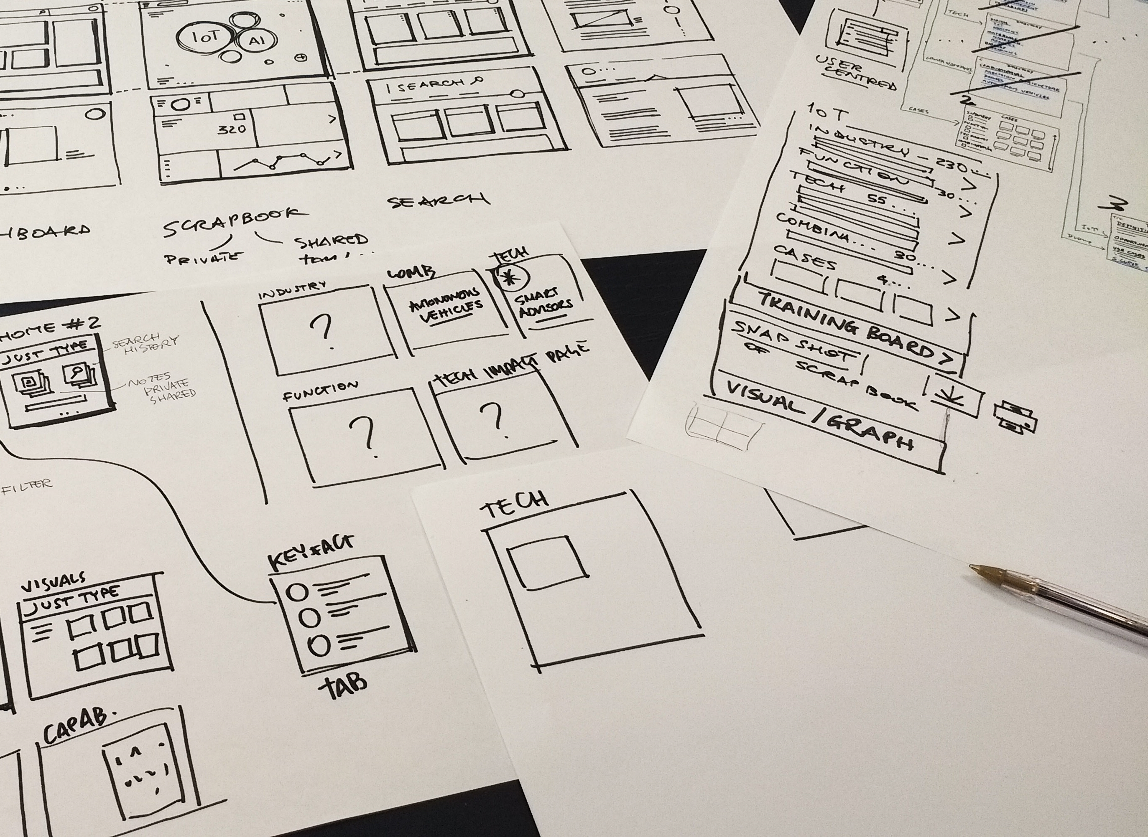
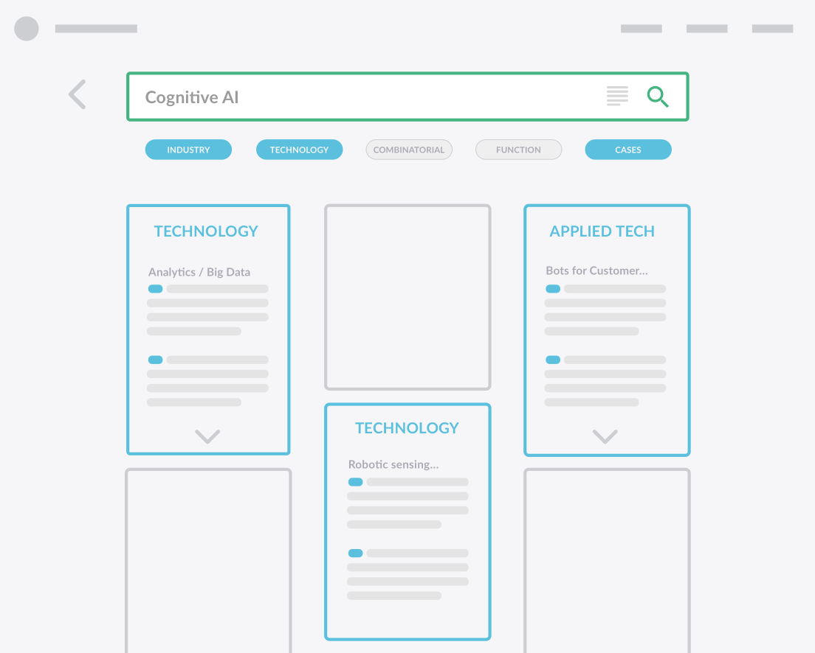
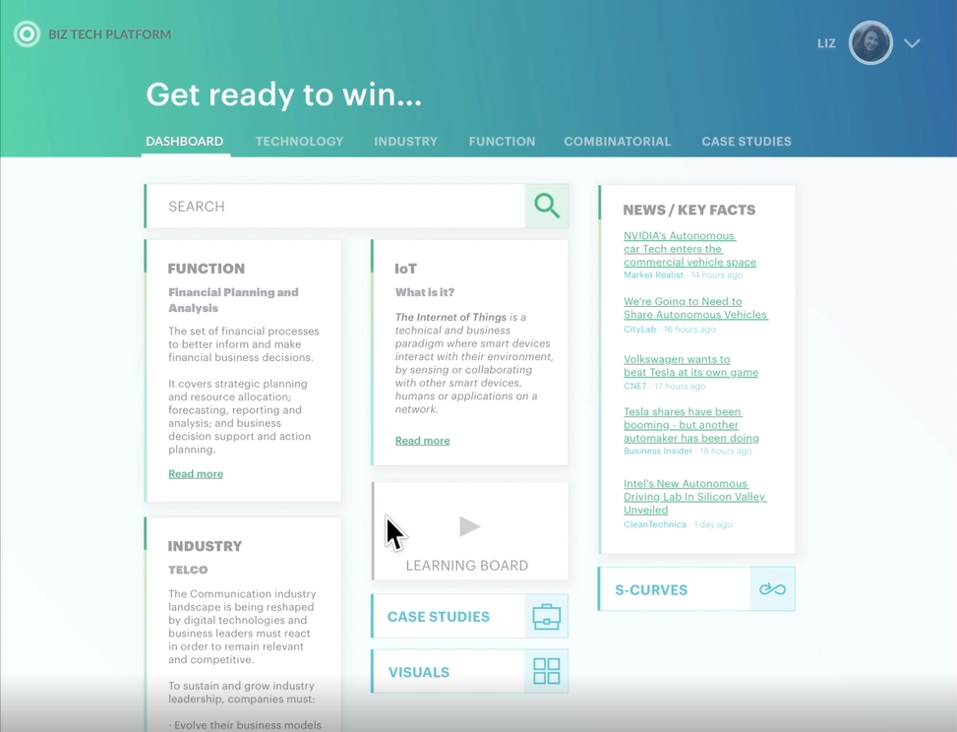
SITE MAP AND PROTOTYPE
Exploring and validating, in different levels, before committing
崔驰坤
崔驰坤
微信15640888106
微信15640888106
Sketch
Low Fidelity
High Fidelity
Hand made explorations
Rapid test of the overall site map
Overall view of the solution
Information architecture and navigation
Atomic design of components
Appropriate visuals

Slide 39
PRODUCT SELECTION AND SOLUTION
崔驰坤
崔驰坤
Data models
for books 1 – 4
CMS selection
Drupal is the strongest
FUNDAMENTAL
CMS IN wave 1
SECURE ACCESS FOR CONTENT
ENTERPRISE SEARCH AND ANALYTICS IN WAVES 2 AND 3
2 DELIVERY CENTER OPTIONS
PRODUCT
微信15640888106
Data Models
Architecture Blueprint
微信15640888106
Delivery Centre Identification
Security Integration
CMS Platform comparisons
Product Selection
Analytics assessment

Slide 40


Journey to a feature-full CMS
崔驰坤
崔驰坤
微信15640888106
微信15640888106
Explore and validate @ the Dock
Build phase
Wave 1
Build phase
Wave 2
Build phase
Wave 3

Slide 41
Navigate
PRODUCT FEATURES
Wave 1
Consume
Navigate using basic capability map,
S-curve, content term or item term
Navigate from industry, to technology, to function
Return Learning Board content as a search result Integration
Interactive S-curve chart
SEO-friendly URLs
Export Content to PDF
Export Content to PPT
Highlight content
Bookmarkable pages
Regional tagging
Versioning
View author information
崔驰坤
崔驰坤
微信15640888106
微信15640888106
Access
Contribute
Personalize
SSO Integration
RBAC
Mobile responsive
Tag/Like content Integration
Feedback on content - errors
Home page personalization
(to be explored)

Slide 42
IP Monitor
Analytics FEATURES
Waves 2 - 3
Reader View
Automatically track where technology companies are investing their R&D funds. Wave 3. Plugin + Dev
Remove clutter from content for better reading experience.
Wave 2. Plugin
崔驰坤
崔驰坤
Metric Finder
Cases Finder
Monitor public sources for live key statistics and metrics relating to particular technologies.
Wave 2. Plugin + Dev
Monitor what leading companies across the industry are doing and saying.
Wave 3. Plugin + Dev
微信15640888106
微信15640888106
Reduction Bot
Grammarly
More…
Automatically summarize content for more rapid consumption.
Wave 2. Plugin
Spell, grammar, writing, style and tone check, with suggestions.
Wave 2. Plugin + Dev
(to be confirmed after Authors interviews)

Slide 43
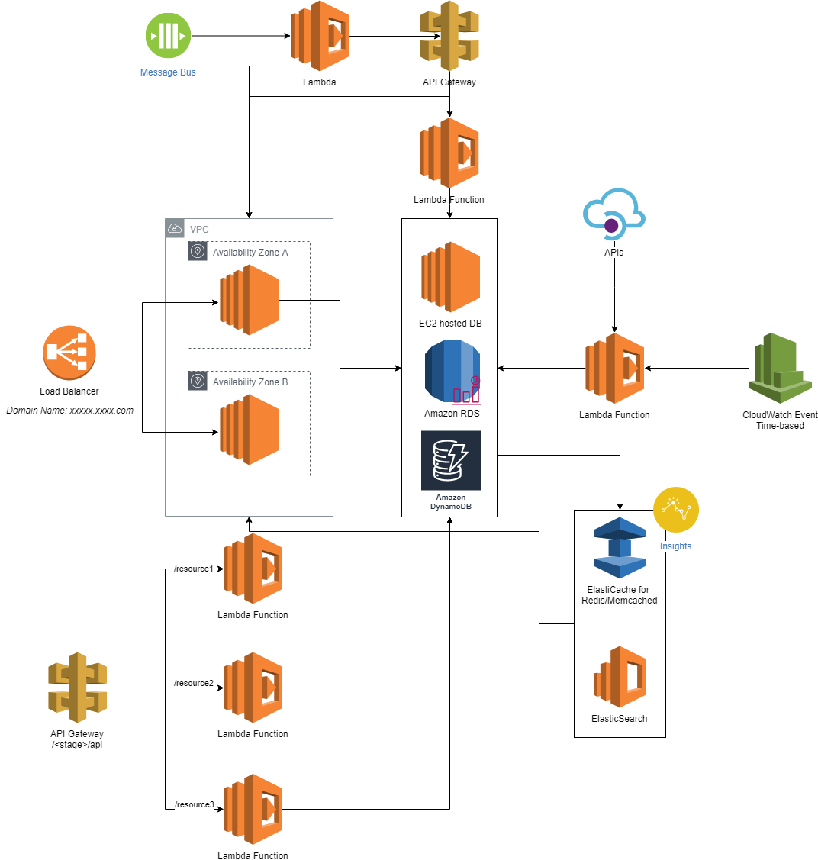
Cloud Architecture
Fully PaaS Adoption
  EC2 virtual machines: hosting Drupal.
  Integrate with Accenture ESO, internal RBAC for readers, authors and reviewers.
  AWS RDS – Aurora with MySQL (InnoDB cluster with 2 nodes) as data storage.
  ElasticSearch: Index and search contents.
  ElasitCache: Cache metadata and hot data from duplicated requests.
  Lambda + CloudFront Events: Schedule batch job, extract data from APIs.
  Lambda + API Gateway: Expose APIs to other web/mobile apps without performance impact to Drupal.
崔驰坤
崔驰坤
微信15640888106
微信15640888106

Slide 44
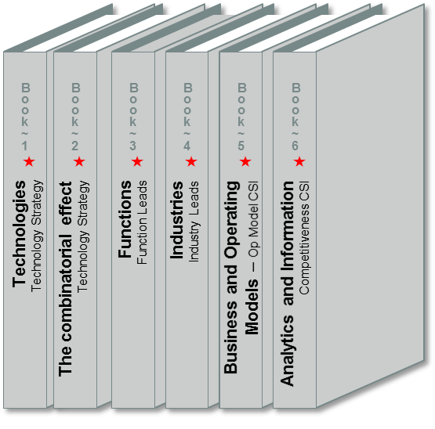




What’s The vision?
CURRENT STATE
THE GOAL
Create a knowledge and collaboration platform to make BizTech content more accessible and relevant to Accenture Strategy practitioners to enable compelling client conversations
崔驰坤
Technology Strategy
Business Strategy
BizTech is Accenture Strategy’s unique positioning at the intersection of business and technology
崔驰坤
BIZTECH
INTERSECTION
微信15640888106
微信15640888106
BizTech “books” were created as core assets for value proposition and differentiation
The book content was stored in multiple formats and locations

Slide 45






What’s currently available ?
崔驰坤
崔驰坤
微信15640888106
微信15640888106
3000+ USE CASES
That support technologies, industries & functions
  300+ TECHNOLOGIES
  With additional technologies coming soon
  INDUSTRY CONTENT
  Retail content with Life Sciences and Communications, Media & Technology and others coming soon
  FUNCTION CONTENT
  Talent & Organization with Customer Insight & Growth Strategy and others coming soon

Slide 46
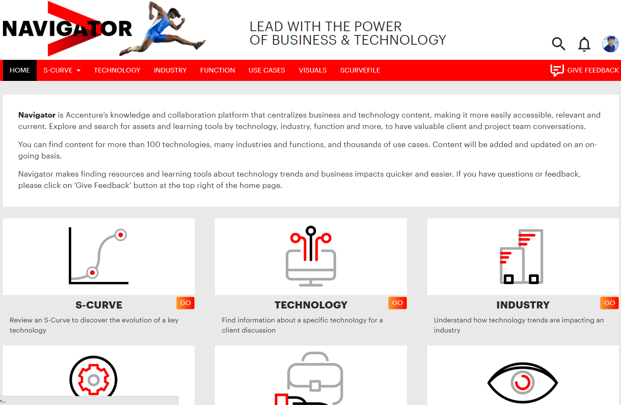
Navigator NOW
崔驰坤
崔驰坤
微信15640888106
微信15640888106

Slide 47
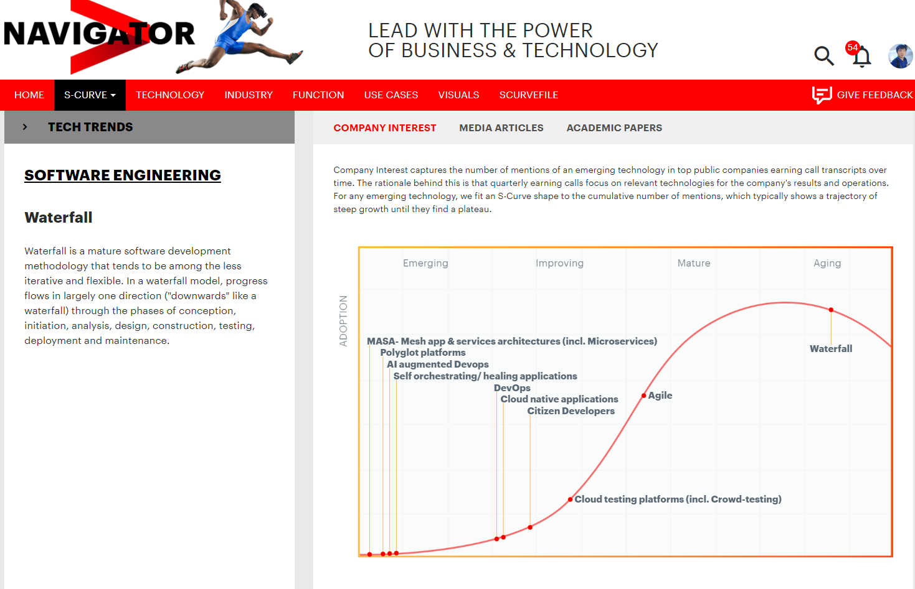
Navigator NOW
崔驰坤
崔驰坤
微信15640888106
微信15640888106

Slide 48
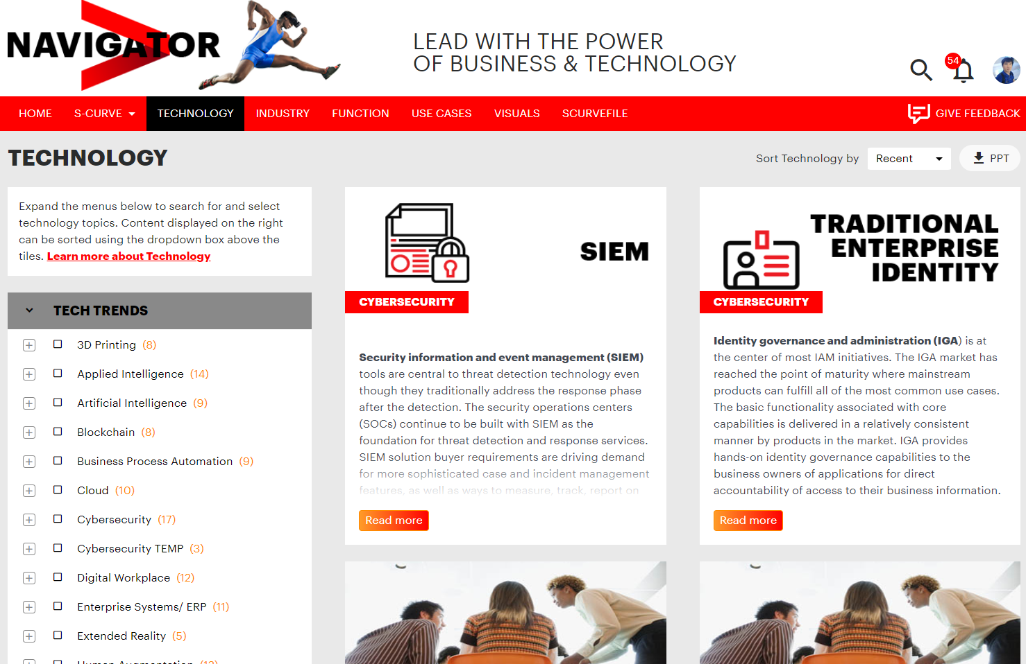
Navigator NOW
崔驰坤
崔驰坤
微信15640888106
微信15640888106

Slide 49
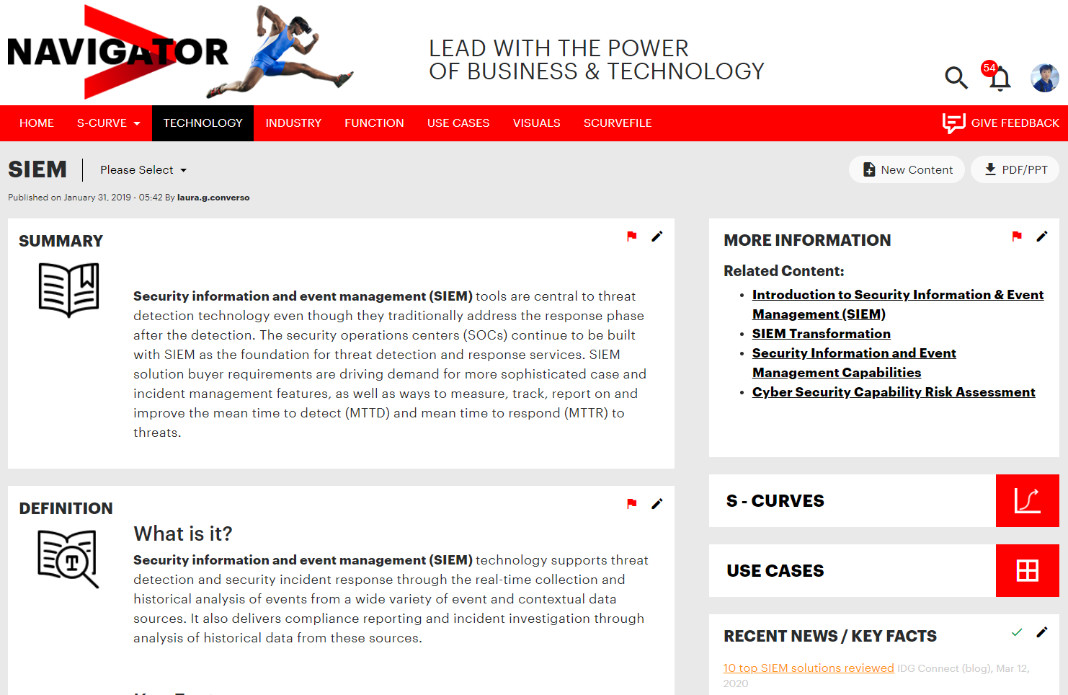
Navigator NOW
崔驰坤
崔驰坤
微信15640888106
微信15640888106

Slide 50
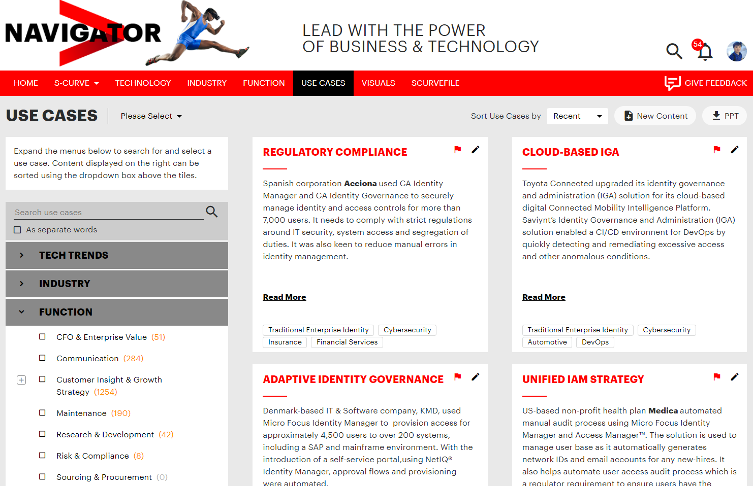
Navigator NOW
崔驰坤
崔驰坤
微信15640888106
微信15640888106

Slide 51
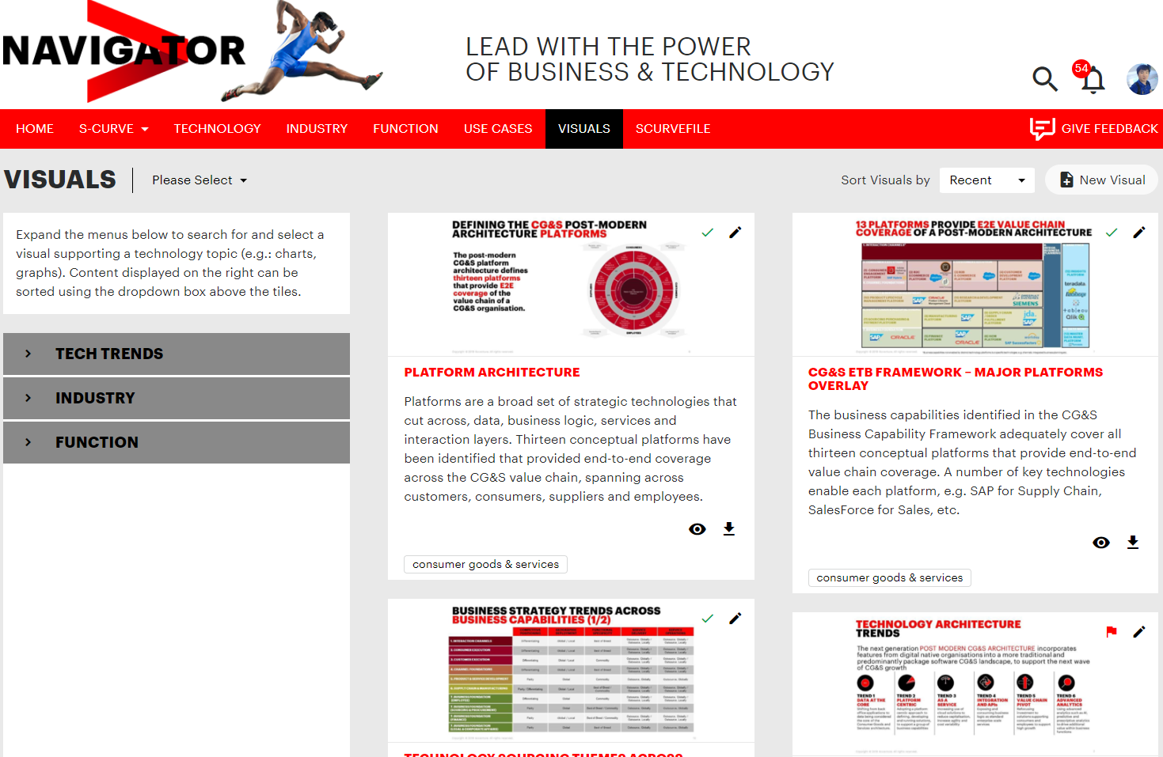
Navigator NOW
崔驰坤
崔驰坤
微信15640888106
微信15640888106

Slide 52
04
崔驰坤
Cloudification for
Roche
崔驰坤
微信15640888106
微信15640888106
Showcase #2
Client: Roche China (SH)

Slide 53

Background
崔驰坤
Roche Shanghai Pharmacy Ltd. Co. plan to take cloudification as its global required.
Most concerned items are internal apps migration to the cloud. Roche team want to understand changes from virtualization to cloudification, or even to cloud native.
They want to know Pros and Cons for cloudification and cloud native app, and plan strategy for further development.
崔驰坤
微信15640888106
微信15640888106

Slide 54
Agenda
崔驰坤
01
02
03
崔驰坤
Accenture Greater China
About Greater China Technology
About Accenture AWS Business Group
微信15640888106
04
05
微信15640888106
Greater China AWS Credentials
Appendix

Slide 55

ABOUT US
  Accenture is a leading global professional services company, providing a broad range of services and solutions in strategy, consulting, digital, technology and operations. Combining unmatched experience and specialized skills across more than 40 industries and all business functions—underpinned by the world’s largest delivery network—Accenture works at the intersection of business and technology to help clients improve their performance and create sustainable value for their stakeholders. With more than 401,000 people serving clients in more than 120 countries, Accenture drives innovation to improve the way the world works and lives.
  The company has been operating in Greater China for 30 years. Today, it has around 15,000 people servicing clients across the region with offices in Beijing, Shanghai, Dalian, Chengdu, Guangzhou, Shenzhen, Hong Kong and Taipei. As Chinese economy experiences the new normal, Accenture will bring more innovation to the business and technology ecosystems and help Chinese enterprises and the government to embrace digitization and enhance global competitiveness to succeed in the new age.
崔驰坤
崔驰坤
微信15640888106
微信15640888106

Slide 56


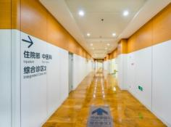


WE HAVE EXPERTISE IN MORE THAN 40 INDUSTRIES ACROSS 17 INDUSTRY GROUPS
Communications, Media & Technology
Financial Services
Health & Public Service
Products
Resources
崔驰坤
崔驰坤
微信15640888106
Communications
Electronics &High Tech
Media & Entertainment
Bank
Capital Markets
Insurance
Health
Public Service
Automotive and
Industrial Equipment
Consumer Goods
And Services
Life Sciences
Retail
Travel
Chemicals
Energy
Natural
Resources
Utilities
微信15640888106

Slide 57
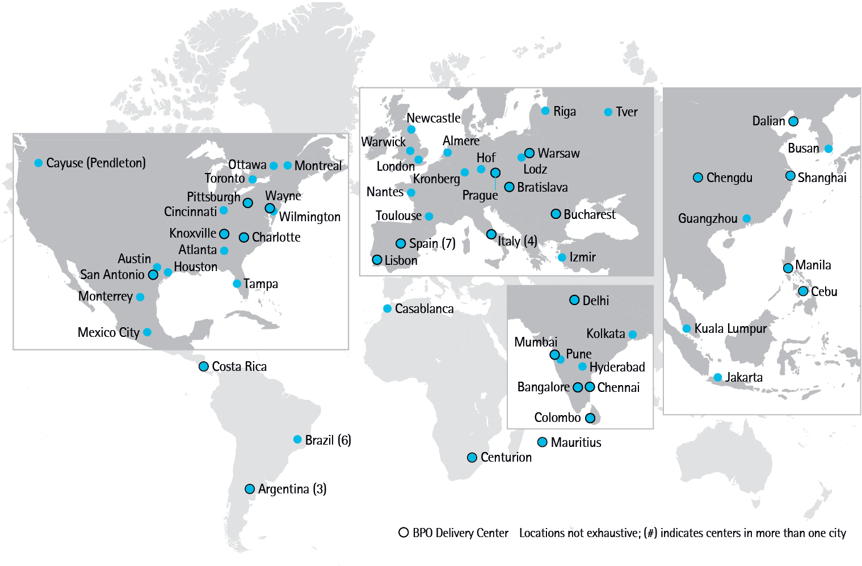













ACCENTURE GLOBAL DELIVERY NETWORK
ENABLES FAST, EFFICIENT, WORLD-CLASS DELIVERY
With over 227,000 service professionals in more than 50 centers, Accenture offices and client locations, the Accenture Global Delivery Network is the largest and most diversified group of operation professionals in the world. We combine our unmatched breadth of industrialized capabilities with insight-driven business innovations to help our clients achieve high performance
崔驰坤
崔驰坤
24+
45+
Years experience
in operation
Languages supported
625+
227,000+
clients
Operation
professionals
微信15640888106
微信15640888106
150+
24/7 Support
Countries where we support client operations
“Follow the sun” model and shifts aligned to client hours
Accenture is a recognized market leader in BPO

Slide 58
Greater China
Technology
崔驰坤
崔驰坤
微信15640888106
微信15640888106

Slide 59




















GREATER CHINA VIEW
7,600+ PEOPLE
1000+ CERTIFICATES
崔驰坤
崔驰坤
150+ CLIENTS SERVED IN APAC
95% WITH >3 YEARS RELATIONSHIP
微信15640888106
3K+ WORKLOAD MIGRATED
2K+ AUTOMATION
ASSETS
微信15640888106
10K+ WORKLOAD MANAGED
8+ LANGUAGE SUPPORT
24*7 SERVICE

Slide 60
HOW ACCENTURE HELPS YOU WITH
JOURNEY TO CLOUD
Accenture Journey to Cloud is an integrated, industry-focused, application and infrastructure enabled set of services that helps clients move their businesses swiftly and safely to the cloud.
崔驰坤
JOURNEY TO CLOUD SERVICES FRAMEWORK
崔驰坤
STRATEGY, ASSESSMENT
AND ROADMAP
PLAN: define your
own journey
CLOUD TRANSFORMATION
AND MIGRATION
MOVE: to a new operating
model and culture
CLOUD
MANAGEMENT
AND OPTIMIZATION
MANAGE: to maximize value
from the cloud
微信15640888106
Cloud Strategy
Cloud Journey Management
Cloud Operations
微信15640888106
Application Migration Assessment and Planning
DevOps Services
Security Operations
Infrastructure Assessment and Planning
Cloud Migration Services
Cloud Optimization
Cloud Application Modernization
Application Management
Cloud Native App Development
Business Process Operations
Cloud PaaS Service
Cloud Infrastructure Transformation

Slide 61
Application Modernization – The “6R” Approach
Infrastructure Request
Service Transition
Decomm
Transformation Control
Realize – Portfolio Evolution
Intelligent Discovery
Remove
Infrastructure Removal
崔驰坤
Remove
Intelligent Discovery
Detailed Design
Rationalise
Cut
over
Infrastructure Removal
崔驰坤
Rationalise
Review
Intelligent Discovery
Detailed Design
Infra Prov
PaaS to PaaS
Cut
over
Infrastructure Removal
Application Modernization Strategy
Benefits Case approved
Relocate
Virtual to Virtual
Relocate
Physical to Virtual
Analyze Current State
Define
Recommendations
Develop Roadmap
微信15640888106
Sprint Planning
Physical to Physical
微信15640888106
Intelligent Discovery
Detailed Design
Infra Prov
Reload
Cut
over
Infrastructure Removal
Remediate
Restore
Benefits case not appropriate for transformation
Remediate
Refresh
Re-platform
Recode
Re-architect
Intelligent Discovery
Detailed Design
DC Close
Relocated
Technology Refresh
Cut
over
Remain
Remain
Lift and Shift
Strategic DC
In Situ Infrastructure Refresh
No Change -> Stranded
Change Bureau
Analyse
Plan
Design
Build
Test
Deploy
ELS

Slide 62
Greater China
AWS Credentials
崔驰坤
崔驰坤
微信15640888106
微信15640888106

Slide 63
Accenture China
Success Cases
JOURNEY TO CLOUD
STRATEGY, ASSESSMENT
AND ROADMAP
CLOUD TRANSFORMATION
AND MIGRATION
CLOUD MANAGEMENT
AND OPTIMIZATION
SITUATION
崔驰坤
Navigator
AWS Application Architecture Design & Implementation
HOW ACCENTURE HELPED
RESULTS
Accenture Navigator Platform is next generation of intelligent content management platform for Accenture Strategy to manage, search and collaborate with contents and their own workflow.
Navigator manages sensitive contents, videos, verity formats of Office documents with stricted classification.
Navigator needs provide fast searching and smooth browsing experiences to global stuff in Accenture Global.
Navigator has been considered as an administrative platform where clients want to migrate all contents in existing apps hosting on-promise.
Technology Architect team design hybrid cloud architecture with variety of IaaS, PaaS and Serverless cloud services. e.g. CloudFront, Load Balancing, EC2, S3, Lambda, Aurora, CloudWatch, Elasticsearch and etc. To implement appropriate capabilities.
DevSecOps and Infra teams create DevOps pipelines for IaaS, PaaS and Serverless with version control, daily build and release management and automate transportation between them. IaC technologies has been applied to automate resources provisioning. They also helps secure contents and docs with security extensions for cloud services from start, like encrypted REST API, signed URL. VPC isolation and etc.
App Dev and APT team ensure apps achieve business and performance requirements and exceed existing apps.
With fully utilization of PaaS and Serverless, team makes cost-efficient and operation effort reduction to cut down 50%+ cost!
Load Balancing and cross-region PaaS and Serverless ensure business resiliency and business continuity. And app can scale out on-demand to satisfy any upcoming data volume and traffic growth in future.
Migrated apps hosting on IaaS to PaaS and implemented ideas with fastest speed to the production and market via Serverless without idle cost.
Benefit clients focusing on business improvement and easily implement complex solution with selectable, scalable, flexible and cost-efficient cloud services.
崔驰坤
微信15640888106
微信15640888106

Slide 64
Accenture China
Success Cases
JOURNEY TO CLOUD
STRATEGY, ASSESSMENT
AND ROADMAP
CLOUD TRANSFORMATION
AND MIGRATION
CLOUD MANAGEMENT
AND OPTIMIZATION
SITUATION
崔驰坤
MyTE
AWS Migration
HOW ACCENTURE HELPED
RESULTS
126 servers and 15 TB Data need to be moved from On-Premise to AWS
Uncertainty on AWS stabilization
Service Down Time should be as short as possible
Well defined cutover plan - From lower Env to production Env, every step follows by Go/NoGo checkpoint
Roll back plan available - Keep old server standby in stabilization period
Combined Incremental backup with full backup to reduce down time
100% Migration AWS successfully
Reduce downtime from days to 15 mins
崔驰坤
微信15640888106
微信15640888106

Slide 65
Accenture China
Success Cases
JOURNEY TO CLOUD
STRATEGY, ASSESSMENT
AND ROADMAP
CLOUD TRANSFORMATION
AND MIGRATION
CLOUD MANAGEMENT
AND OPTIMIZATION
SITUATION
崔驰坤
MyTE
AWS Operation
HOW ACCENTURE HELPED
RESULTS
Ensure 126 AWS servers stability and performance to support 500K users
Address production incidents quickly to meet SLA
Regular review and adjust AWS configuration
Auto Deployment - Using Octopus and SSS to do script deployment
Auto monitoring - AppDynamics tool used to check server health in real time
Performance Improved (11x up):
200K records delivered to downstream application costs:
12 to 1 (Hour) for processing time
Stabilization after migration (4x up):
5 to 1 (Outage) in a year
Efficiency improved (17x up)
72 to 2 (hours) for average incident resolution time
崔驰坤
微信15640888106
微信15640888106

Slide 66
HA, Scalability
& App Migration
崔驰坤
崔驰坤
微信15640888106
微信15640888106

Slide 67
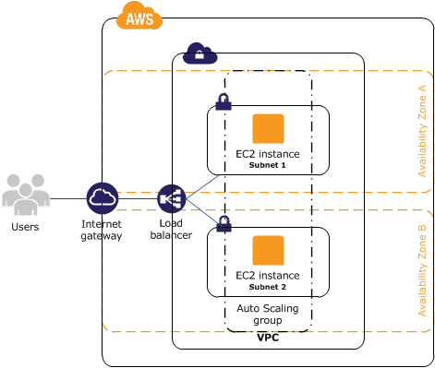
HA & Scalability for Roche Tools only in China
崔驰坤
Single Region, Multi-AZ (single node in one AZ or one node with auto scaling group)
Beijing Region: primary region in China, high bandwidth and low latency (with Shanghai and retro cities in China).
2 availability zones for high availability.
Auto scaling group with min 2, max 8 nodes for peak performance required and save cost in normal.
崔驰坤
微信15640888106
微信15640888106

Slide 68
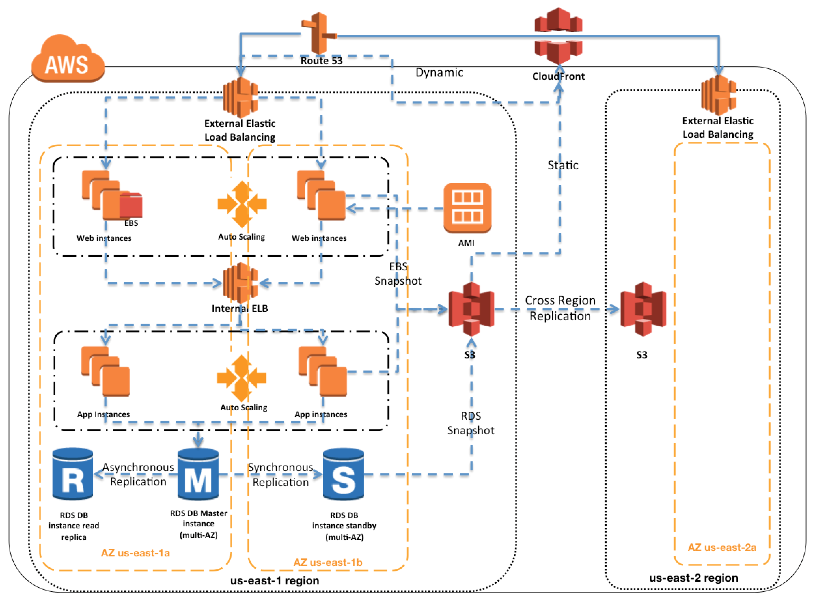
HA & Scalability for Roche China Enterprise App
崔驰坤
Multi-Region, Multi-AZ
Beijing region as primary region
Ningxia region as secondary region
All service components including VMs and DBs have images or backups which can transfer and recover in secondary within hours.
崔驰坤
微信15640888106
微信15640888106

Slide 69
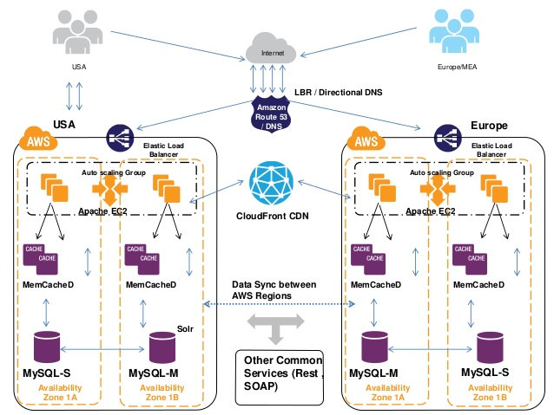
HA & Scalability for Roche Global Enterprise App
崔驰坤
China and Europe regions with active services.
Hongkong Region & Europe Region
Route 53 (DNS) with latency routing rules to provide access nearby.
Data sync-up between regions. During disaster, VPN access is able to share for temporary usage and latest data will refresh in few hours.
崔驰坤
Hongkong
微信15640888106
微信15640888106

Slide 70
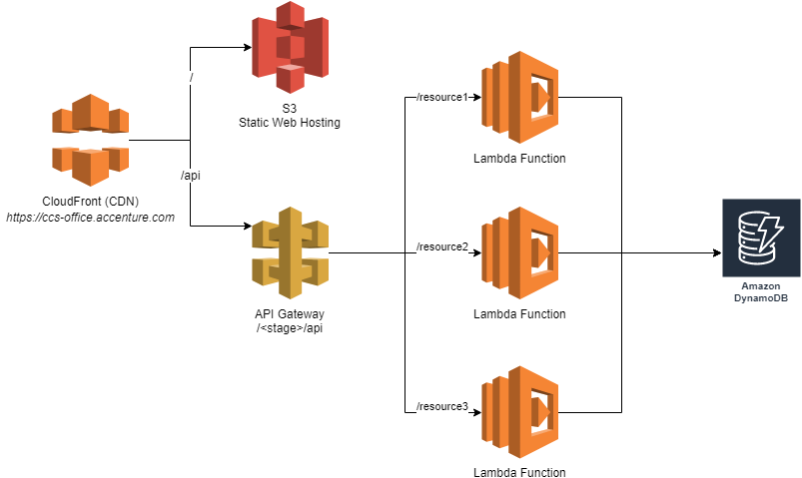
Re-Arch to Serverless
Innovation, Online Tools
  Decoupled Frontend
  CDN speed up
  API management (with versioning and canary deployments)
  Compute with fast scale and performance (limits: 1000 concurrent executions, 3GB memory)
  Fast to market
崔驰坤
崔驰坤
微信15640888106
微信15640888106

Slide 71
Re-Platform
PaaS Adoption
  Messaging integration
  API integration
  Data ingestion
  Side car project
  Serverless APIs on legacy system (no impact to compute resources) for mobile and other apps
崔驰坤
崔驰坤
微信15640888106
微信15640888106

Slide 72
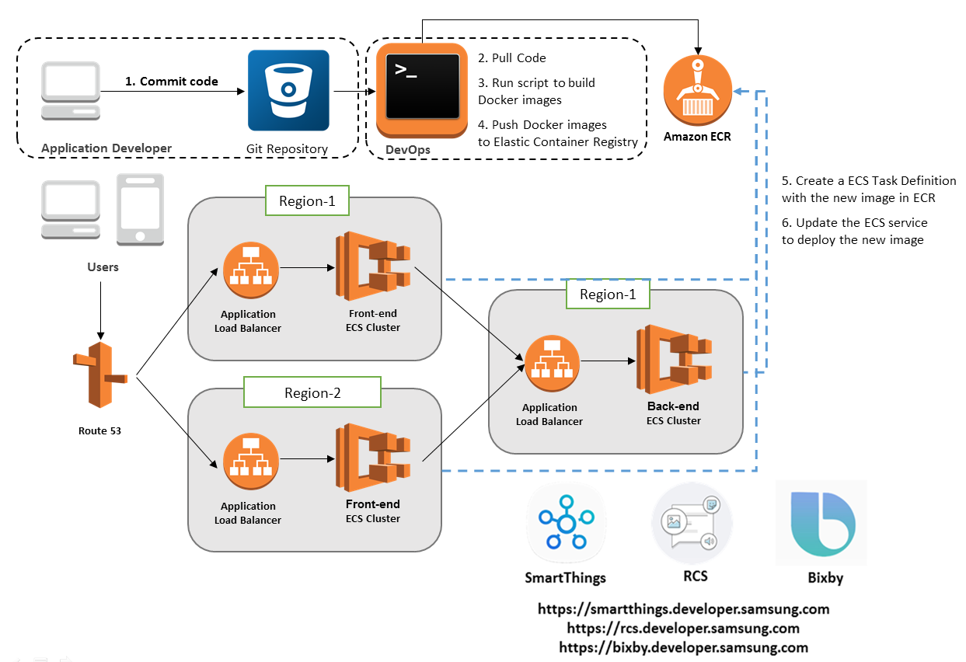
Build/Re-Arch Enterprise App with Microservices
  Decomposition by business and subdomain
  Integration with gateway and proxy
  Design database by service
  Monitoring and logging
  External configurations, service discovery and circuit breaker, blue-green deployment
崔驰坤
崔驰坤
微信15640888106
微信15640888106

Slide 73
Architecture & Methodologies
崔驰坤
崔驰坤
微信15640888106
微信15640888106

Slide 74
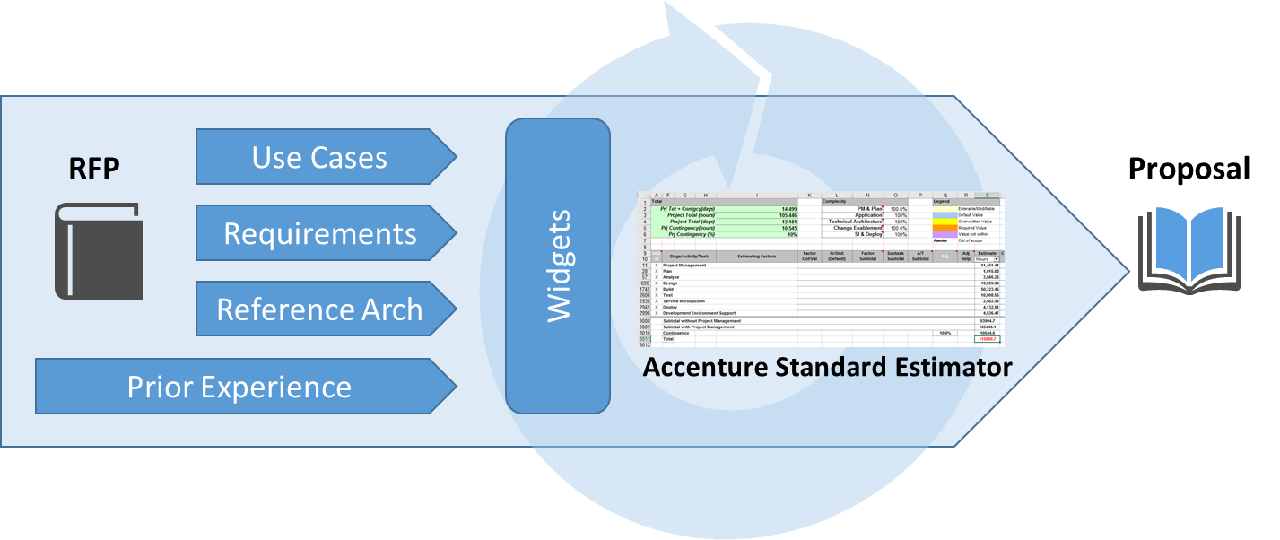
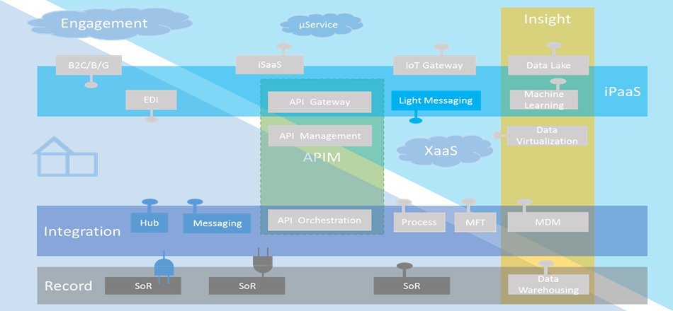
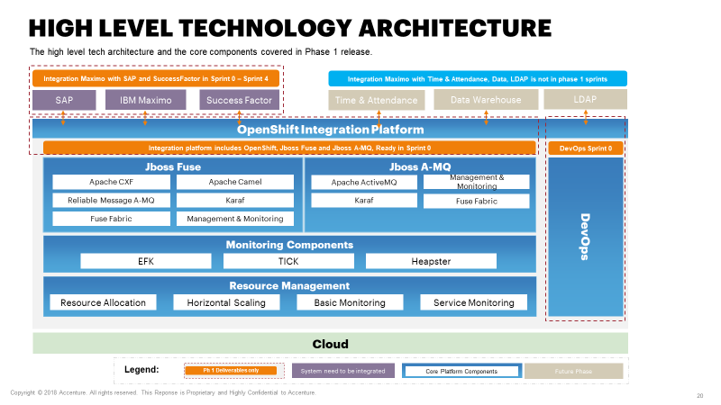
Overview and understanding
Our proposed solution approach maximises the flexibility and value creation while keeping the implementation risk under control; we do so by leveraging the experience we have from prior work
Our solution is based on
  Your Use Cases
  Your Requirements
  Your Reference Architecture
  Our Estimators proven from past delivery
  Our solution considers success factors
  To minimise the delivery risk
  To maximise the flexibility
  The need for architectural understanding and experience
  Core elements of the resulting solution include
  Solace as core integration component
  Agile delivery approach
  Consistent framework
  Your proposed software products from the RFP and Reference Architecture
崔驰坤
崔驰坤
微信15640888106
微信15640888106

Slide 75
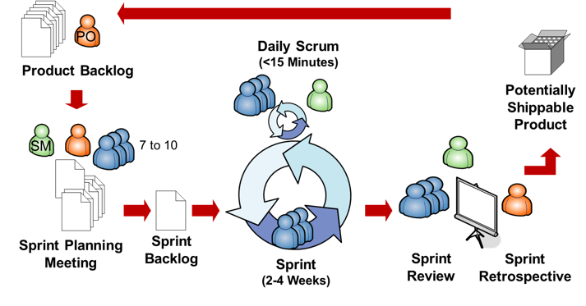
Our Methodology
Our team would suggest the delivery to be done using the Agile methodology. Instead of completing the development of the entire solution in one go, the solution will be componentized, prioritized, and planned into development iterations (a.k.a. sprints). As such, Universal will be able to see the incremental deliverables and value after each development sprint, and the team will be able to enjoy benefits such as better transparency and visibility, early risk identification and mitigation, early and frequent testing, etc.
崔驰坤
In a nutshell, the below activities will happen during the development cycle:
崔驰坤
Activity | Frequency | Participants | Objective
Sprint Planning | Once per sprint | Product Owner, Scrum Master, Developers, Project Manager (optional) | To decide what to be delivered after the Sprint and what to do to deliver the goal
Daily Standup | Daily | Scrum Master, Developers | To review what each developer has done on the previous day, what he / she will do on that day, and to report on any impediment that block the team progress
Show Case | Once per sprint | Product Owner, Scrum Master, Developers, Project Manager (optional) | To show case to Product Owner(s) the deliverables that are completed
Retrospective | Once per sprint | Scrum Master, Developers, Product Owner (optional) | To inspect how the last sprint has been and identify potential improvement
微信15640888106
微信15640888106
Show Case
ILLUSTRATIVE
NOTE: As Universal Beijing has already defined the scope of integration, middleware, message and PaaS, the traditional backlog and planning will precede kickoff.
It is also assumed that Universal is familiar with needed roles and participants for successful delivery

Slide 76




Our agile delivery methodology shipped with a set of management tools
Having delivered many projects of similar size, scale and makeup globally, Accenture has invested in assets to aid in the de-risking of delivery and acceleration of outcomes
Backlog management
SPRINT PLANNING
崔驰坤
崔驰坤
微信15640888106
ILLUSTRATIVE
微信15640888106
Scrum delivery
Devops

Slide 77
SPRINT REALIZATION
SPRINT PLANNING**
DEVELOPMENT PERIOD***
SPRINT REVIEW
SPRINT RETROSPECTIVE
崔驰坤
崔驰坤
Sprint planning for upcoming Sprint.
Stand-up meetings conducted with impediments identified by team
Collaborating with Product Owner on Scrum team in providing guidance
    Backlog reviewed and discussed if changes are needed.
The Product Owner (PO) explains what is done
Collaborative discussion on issues/etc. Identification and resolution plan for dependencies and impediments cross teams
Development and testers with Sprint material updated and transitions deliverables to other teams
The Development Team showcase work is “Done”
微信15640888106
Review of the timeline, budget, potential capabilities for the future
微信15640888106
Prior to every sprint, we will have a review/plan session to confirm on the plan, impediments, prioritizations and dependencies across all teams. This will ensure that all is ready to enter the sprint. Product owner will be required to review.
  There will be a sprint review at end of each sprint to showcase to PO developed shippable product, and the PO is required to review
  On the last day of every sprint, we have a quick retrospective to reflect on how the sprint went and what’s needed next sprint.
  At the end of each sprint, all teams must align to discuss progress on both sides. This is to:
    Ensure all the Sprint goals are met with external dependencies
    Mitigate the potential risk of each team running in different delivery methodologies
** Impediments are to be identified before a sprint starts
*** In order to ensure the velocity and momentum of the sprints, Product Owners and Universal team are expected to respond to queries within one day. Otherwise, the scope may be delayed to the next sprint.

Slide 78
PROJECT TIMELINE
As outlined in our delivery approach, Accenture has defined a series of Agile delivery sprints targeted at delivering the scope needed for Universal’s integration initial business needs.
May
June
TBD
Phase 1
崔驰坤
Initiation and Sprint 0
Development Sprints
崔驰坤
微信15640888106
UAT
微信15640888106
Training
Phase 2
Notes and Assumptions:
For Phase 1
Phase 1 includes the setup of OpenShift, JBoss Fuse and JBoss A-MQ, implementation from INT_001 to INT 007.
Unit and SIT testing will be completed within development sprints.
Design documents, testing, and training material preparation will be prioritized and planned within development sprints.
For Phase 2
Phase 2 includes migration Phase 1 results to data center and maintenance tasks.
Phase 2 effort does not include implementation of INT_008 to INT_010.

Slide 79








Our solution
We have derived a solution and plan that aligns with the Universal integration delivery needs across 6 key areas that we believe holistically will achieve the outcomes Universal requires
1
2
3
崔驰坤
崔驰坤
微信15640888106
4
微信15640888106
5
6

Slide 80










Devops Architecture
Accenture has invested in and created the Accenture DevOps Platform (ADOP®) leveraging leading practice tools for managing DevOps throughout delivery
Continuous Integration
Continuous Delivery
Continuous Deployment
Local or cloud-hosted development environment integrated to source code repository via code review server
Autonomous build and testing of code submission
Quality gates enforced using standardized tests against re-usable components and libraries
Managed roll-out of new features
崔驰坤
崔驰坤
Goal
Requirement
SCM
Code Quality
Unit Test
Build & Package
Artifact Management
Environment Provisioning
Testing
Make the entire lifecycle more efficient, consistent, and repeatable
Increase the quality of code produced by developers
Eliminate inconsistencies between development, test and production environments
Significantly improves the speed of delivery
Automate testing, integration, packaging…
Fast environment provisioning
微信15640888106
微信15640888106
Requirement management, Defect management
Gitlab workflow
Code quality scan
Unit Test
Build & package and passed to CI platform
Unified artefacts repository
Continuous, automated deployment; Containerized; Microservice based; Supporting automated scaling & service orchestration etc.
Functional Test, Performance Test
NOTE: DevOps tools (with the exception of OpenShift) are free tools. If Universal has and existing DevOps stack in place, Accenture can discuss alternatives

Slide 81
05
崔驰坤
Contract Insights Platform
崔驰坤
微信15640888106
微信15640888106
Showcase #3
Client: Accenture DBS

Slide 82

Background
崔驰坤
Contract Insights Platform is built and release in end of 2017. The app is for Legal team and lawyers to identify risks and share comments on the business opportunities.
After approval on the opportunities, the request will flow to contract management system for next steps.
It has been handled by teams and heavy with IaaS and database store procedures.
DBS global asked help from EA and CIO China who take the enhancement tasks to assign a tech arch review for current and make plan for future with right architecture.
崔驰坤
微信15640888106
微信15640888106

Slide 83

Architecture Blueprint (As-Is)
崔驰坤
崔驰坤
微信15640888106
微信15640888106

Slide 84

Issues Found
Object Type | Count
Tables | 136
Views | 33
Functions | 6
Procedures | 31
Table Variables | 66
Temporary Tables | 24
崔驰坤
    Main data-process logics within store procedures are hard-coded, complex. It needs a flexible way to reduce complexity e.g. Workflow.
    1) heavy “Joins” with sub queries 2) more table variables may slow down performance, database optimization is required.
    CPU utilization is not stable and some time long wait queue happened due to slow queries. No non-cluster index.
    Lack of app monitoring e.g. CloudWatch metrics for webservers, AppDynamics or PIWIK.
    Different code styles exist, core re-factoring is required.
崔驰坤
Operation Type | Count
Inner Join | 752
Left Join | 371
Right Join | 1
IN+SELECT | 33
FROM+SELECT | 21
微信15640888106
微信15640888106

Slide 85



Database Performance Review
Questions
崔驰坤
Is this metrics for production database server?
What happened on 20th March which reduce storage down to 3Gb only? (4GB has gone and only 3GB left, it’s a dangerous signal)
CPU utilization is unstable, and peak value almost reach 90%. It should be long running task or performance issue.
According to queue depth, what happened on 17th and 20th March? Seems some transaction stuck there.
Database diagnostics are required to identify database performance issue and storage loss.
崔驰坤
微信15640888106
微信15640888106

Slide 86
CIP TA Documentation Review
崔驰坤
    TA223 CIP Application Architecture Specification.docx (updated on 6/11/2018)
    PL181 CIP Technology Capacity Plan.docx (updated on 11/19/2019)
    TA357 - https://ta357.accenture.com/Info/Applications/7821 (update required)
    AP250 - CIP Integration Conceptual Design.docx (updated on 11/17/2017)
    AP265 Conceptual Data Model CIP - R1.0.docx (updated on 12/6/2017)
    Most of information is not accurate with current, e.g. TA357 shows ELB connects database directly, and server specification is different.
    Action required: Please update TA documents accordingly.
崔驰坤
微信15640888106
微信15640888106

Slide 87
Actions Recommended for Performance Optimization
崔驰坤
Actions
    Record most concerned transactions
    Capture top slow transactions in database
    Analyze procedure with query statistics
    Analyze views/queries with execution plan / MS SQL Profile
    Identify performance issue with big queries and complex joins
    Create appropriate non-clustered indexes to speed up queries
    Reduce complexity of queries
    Try to remove table variables/temporary tables if not required
    Cache hot data with levels and lifecycle management (invalidation)
崔驰坤
微信15640888106
微信15640888106

Slide 88
Architecture Roadmap (for a short term target)
崔驰坤
Database performance optimization
Scale web servers with auto scaling group
Testing application performance with key business processes for continuous improvement
Setup monitoring tool accordingly e.g. CloudWatch metrics, PIWIK and AppDynamic. To collect performance, user behaviors, execution time to support continuous improvement.
崔驰坤
微信15640888106
微信15640888106

Slide 89
Architecture Roadmap (for a long term target)
崔驰坤
Extract hard coded branches or logics from store procedures and make it a flexible way e.g. Workflow
Apply more messaging(e.g. REBAR messaging) and async processing(Lambda) for integration or data processing and transferring.
Apply autoscaling group for a workaround, re-architect main logics with microservices architecture with Web Apps or Service Fabric. (Since database is migrating to Azure SQL MI, it’s better to reduce cost and network latency among two cloud vendors)
Upgrade to .NET 3.0 Core (speed up data query with new EF) and Angular 9 (Ivy engine will save 40% performance) if possible.
Apply Elasticsearch or caching services to speed up and reduce queries.
崔驰坤
微信15640888106
微信15640888106

Slide 90

Architecture Blueprint (To-Be)
崔驰坤
崔驰坤
微信15640888106
微信15640888106

Slide 91

Blueprint (to-be for clarifying domains/scopes)
崔驰坤
崔驰坤
All up/down streams use messaging bus to sync up data. Keep data near-real-time and reduce API consumptions.
Extract general functionalities e.g. master data mgmt., workflow and etc. Make these components flexible with configurations and data-driven.
Apply Domain-driven design and microservices architecture to make architecture clear to teams.
微信15640888106
微信15640888106

Slide 92
崔驰坤
崔驰坤
Thank you for your time
微信15640888106
微信15640888106

